Slide 1
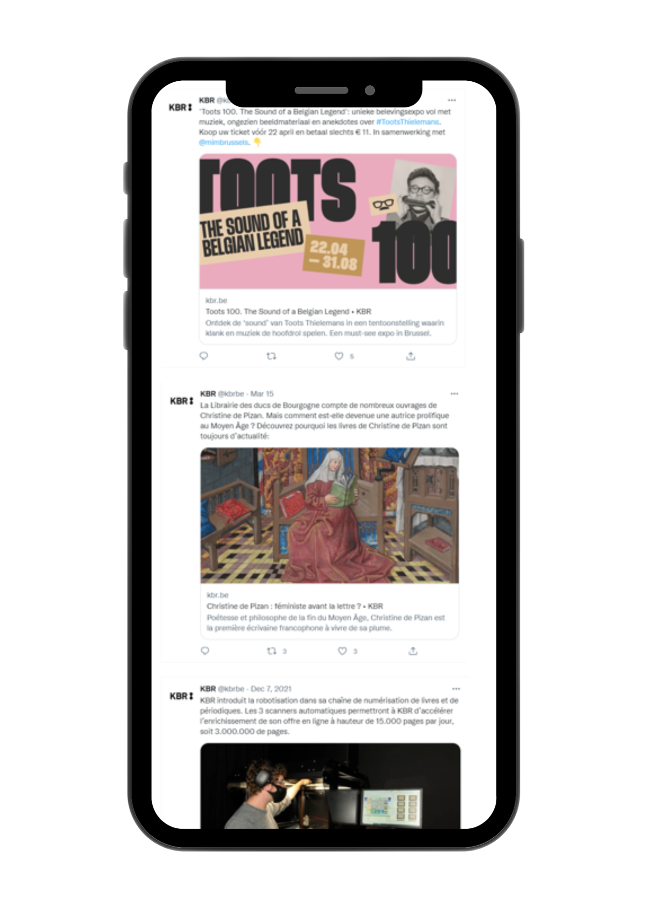
Unlocking archived born-digital data
Friedel Geeraert | KBR
Christina Vandendyck | KBR
Eveline Vlassenroot | imec-mict-UGent
15th of October 2024
Bijeenkomst Praktijknetwerk sociale media archiveren: toegang en gebruik in beeld
Den Haag, The Netherlands

Slide 2
Agenda
Getting familiar
Short intro to the BelgicaWeb project
Workshop "Conversation Carousel":
                Topic 1: Selection of content
    Topic 2: Access
    Topic 3: Enrichment
Wrap-up

Slide 3
Housekeeping
Photo permission: We will be taking some pictures during the workshop to capture our time together. Please let us know if you have any concerns or if you prefer not to be in the photo.
Open communication: We encourage everyone to share their thoughts and experiences. Remember, there are no wrong answers here. Every comment is valued, and we appreciate your contributions. Please make sure to listen respectfully when others are speaking.
Stay engaged: Active participation is encouraged, and we want everyone to get the most out of today.
Questionnaire completion: At the end of the workshop, please take a moment to fill out the paper questionnaire. Your feedback is invaluable.

Slide 4
GETTING FAMILIAR
Notes:
Let’s do the introduction first

Slide 5

Who uses born-digital content for their research?
Image from cottonbro studio (Pexels)

Slide 6
Have you ever used a web and/or social media archive?
Image from cottonbro studio (Pexels)

Slide 7
INTRODUCTION
Notes:
Let’s do the introduction first

Slide 8
NATIONAL WEB ARCHIVES SINCE 1996...
1996
Australia: PANDORA
UK Government web archive
1999
New Zealand web archive
2001
Norwegian web archive
1997
Sweden: Kulturarw3
2000
USA: Library of Congress web archive
Czech Republic: Webarchiv
2002
France: BnF web archive

Slide 9


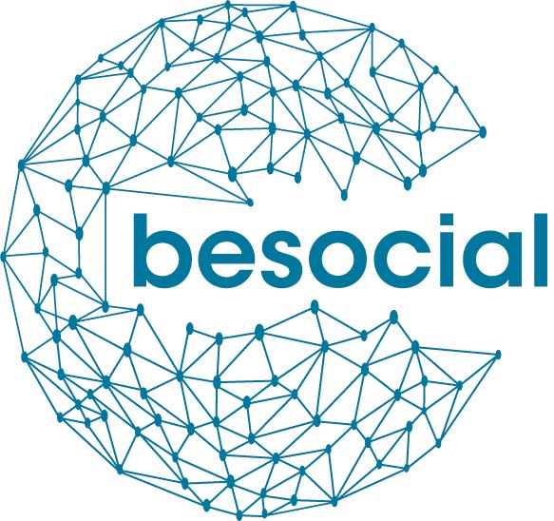

… BUT WHAT ABOUT BELGIUM?
2017 – 2019
Focus on
archiving websites
2020-2022
Focus on
social media
archiving
2024-2026
Focus on
opening up Belgium's born-digital heritage

Slide 10
THE BELGICAWEB PROJECT
3-year research project funded by BRAIN-be (BELSPO): pillar 2 heritage science
Aim: Open up Belgium’s born-digital heritage and make it FAIR
Objectives
  Investigate how to sustainably provide access to these collections
  Develop the necessary data infrastructure
  Enrich the (meta)data via linked data, NLP or other digital methods
  Analyse the relevant legal frameworks
  Promote Belgium’s born-digital heritage

Slide 11







THE BELGICAWEB TEAM
Friedel Geeraert Christina Vandendyck | KBR KBR
Alejandra Michel Cécile de Terwangne Elodie Lecroart | UNamur (CRIDS) UNamur (CRIDS) UNamur (CRIDS)
Peter Mechant Eveline Vlassenroot | UGhent (MICT) UGhent (MICT)
Dieter Dewitte | UGhent (IDLab)
Fien Messens (ad interim) Julie M. Birkholz | UGhent (GhentCDH) KBR and UGhent (GhentCDH)

Slide 12
Workshop outline
Notes:
Let’s do the introduction first

Slide 13
GOAL OF TODAY'S WORKSHOP
Enhance scientific exploitation: Develop strategies to improve access and use of born-digital archived (social media) content
Promote social valorisation: Foster interdisciplinary exchanges to expand the societal benefits of utilising born-digital archives.
=> Gain insights and understand the needs and requirements of researchers for selection, access, enrichment of born-digital archived (social media) content.

Slide 14
INTRODUCTION – Gain insights into user requirements
Personas are fictional characters, created based upon research in order to represent the different user types that might use a service, product, … in a similar way. Creating personas helps us to understand users’ needs, experiences, behaviors and goals.
Are there existing personas for access and use of born-digital archived (social media) content?
Notes:
How can we gain insights and understand the needs and requirements of researchers for access and use of born-digital archived (social media) content?

Slide 15





BESOCIAL persona's
Bart
Febe
Ben
Manou
Jan
post-doc researcher in communication sciences
PhD-student in computational linguistics
35-year old journalist working for the newspaper
28-year old scientific researcher @KBR
68-year old former team coordinator
Personas created based on in-depth interviews and survey data (n=399, see https://bit.ly/dashboardPROMISEBESOCIAL for interactive Tableau dashboard) within the context of Belspo funded projects PROMISE & BESOCIAL (2020-2022).

Slide 16
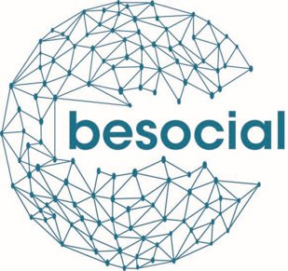
Persona #1: Bart
Age & Profession:
42-year old post-doc researcher in communication sciences
Goal for using social media archive:
His abstract got accepted and now he and his assistant need to urgently start researching the hypothesis that ‘more extreme political parties post more ‘populist’ content/messages on Twitter’. In order to do that they need the tweets of all Belgian political parties tweeted over the last year.
Professional situation: Although Bart has some programming expertise, acquired more than a decade ago, he feels that he is not up to date. Moreover, because of a heavy workload, he feels that he lacks the time to thoroughly learn/acquire new skills that are required. He has little to no expertise in working with big data nor expertise in working with analytical software that can process those big datasets.

Slide 17
Persona #2: Febe
Age & Profession:
24-year old PhD-student in computational linguistics
Goal for using social media archive: Febe is trying to develop a methodology for sentiment analysis and subjectivity detection through the deep semantic analysis of text published via social media channels. In order to train and test her code, she is looking for a big data set with (textual) social media content.
Professional situation: In her first year, colleagues with more expertise helped her a lot with mastering the programming techniques and analytical software that are key in her field. This year she is following dedicated courses that focus on advanced programming through the high-performance computer cluster that her university makes available.

Slide 18
Persona #3: Ben
Age & Profession:
a 35-year old journalist working for a newspaper
Goal for using social media archive: For an article on ‘fake news’ Ben needs to collect examples of fake news (posts) on social media that were posted in the past.
Professional situation: Ben is known for his resourcefulness and for the fact that he likes to tinker with technology and software. However, Ben has never had a formal education in programming languages or techniques, nor does he have expertise in working with big data or analytical software.

Slide 19
Persona #4: Manou
Age & Profession:
28-year old scientific researcher @ national library
Goal of using social media archive: Manou wants to conduct exploratory research by means of close reading of pertinent social media channels and accounts to see whether social media comments exist on digitised heritage collections. In order to kick-off the collection she aims to collect as much as social media content as possible on already digitised heritage collections.
Professional situation: Manou studied information and communication sciences (during which she picked up some basic digital literacy skills).

Slide 20
Persona #5: Jan
Age & Profession:
68-year old former team coordinator at a car manufacturer, now retired.
Goal of using social media archive: Jan regularly writes blog posts for the website of the Belgian China-Belgium club. For one of these blog posts, he would like to elaborate on how China is described and framed in Belgium, in particular on how China is portrayed on Belgian social media and how this discourse evolved over time. In order to do this, he needs all Belgian social media content about China he can get his hands on.
Professional situation: Jan used to be a team leader at a car manufacturer. For this job, he had to regularly travel to China. Jan has no programming expertise, nor is he acquainted with big datasets or analytical software.

Slide 21
Can you identify with one (or more) of the personas?
Image from cottonbro studio (Pexels)

Slide 22
Overview personas
Bart
Febe
Ben
Manou
Jan
post-doc researcher in communication sciences
PhD-student in computational linguistics
35-year old journalist working for the newspaper
28-year old scientific researcher @KBR
68-year old former team coordinator
Goal: Investigate if more extreme political parties post more populist content on Twitter, needing tweets from all Belgian political parties over the last year.
Professional Situation:
Outdated programming skills
Lacks current expertise in big data and analytical software
Heavy workload
A lack of time to acquire new skills
Goal: Develop methodologies for sentiment analysis and subjectivity detection through deep semantic analysis of social media texts, requiring a large dataset of textual social media content.
Professional Situation:
In the process of mastering advanced programming techniques through dedicated courses and access to high-performance computing, enhancing her capabilities in handling large datasets
Goal: Collect examples of fake news on social media for an article, needing historical posts that contain fake news.
Professional Situation:
Known for his resourcefulness and affinity for tinkering with technology and software
Lacks formal education in programming and expertise with big data or analytical tools.
Goal: Conduct exploratory research on social media comments related to digitized heritage collections, aiming to collect as much relevant social media content as possible.
Professional Situation:
Has basic digital literacy skills from her studies in information and communication sciences
Limited advanced digital capabilities.
Goal: Write about how China is portrayed in Belgian social media over time, requiring comprehensive data on all Belgian social media content about China.
Professional Situation:
Lacks programming expertise
Not familiar with big datasets or analytical software
Relying on basic tools and potentially needing assistance for complex data handling.

Slide 23
2. Workshop instructions "Conversation Carousel"
Group assignment: Join a group based on one of the three BESOCIAL personas (max 3 personas, hence 3 groups).
Persona immersion: Step into the shoes of your assigned persona, considering their interests, skills, and expertise.
Select a web archive use case: Individually, choose a social media web archive for discussion, considering:
  Your institution’s archive,
  A best-practice example, or
  A web/social media archive from the provided list.
Group Discussion on 3 key topics (rotate):
  1) Selection: How would your persona see the content selection for a (social media) web archive?
    Write individual thoughts on post-its (3 min).
    Cluster and discuss ideas as a group (7 min).
  2) Access: How does your persona envision user-friendly access to this archive (e.g., interface or API)?
  Write individual thoughts on post-its (3 min).
  Cluster and discuss ideas as a group (7 min).
  3) Content enrichment: How would your persona prefer to see the archived content enriched or enhanced?
  Write individual thoughts on post-its (3 min).
  Cluster and discuss ideas as a group (7 min).
Wrap-up: All groups reconvene to share key insights.

Slide 24
Topic 1: Selection
How would your persona see the content selection for a web and social media archive?
Notes:
Let’s do the introduction first

Slide 25

How would your persona see the content selection for a (social media) web archive?​
Assuming no practical or legal hurdles!
Regarding who selects the content
Regarding which content is selected

Slide 26
Topic 2: Access
How does your persona envision user-friendly access to this archive (e.g., interface or API)?
Notes:
The importance of web and social media archiving is gaining recognition. Efforts are being made to enhance archiving methods, streamline the overall process, and create more collections for public access.

Slide 27
How does your persona envision user-friendly access to this archive?
Assuming no practical or legal hurdles!
Search interface
Search results
API

Slide 28
Topic 3: Content enrichment
How would your persona prefer to see the archived content enriched or enhanced?
Notes:
The importance of web and social media archiving is gaining recognition. Efforts are being made to enhance archiving methods, streamline the overall process, and create more collections for public access.

Slide 29
How would your persona prefer to see the archived content enriched or enhanced?
Assuming no practical or legal hurdles!

Slide 30
WRAP-UP

Slide 31
Thank you!
Notes:
Let’s do the introduction first

Slide 32
Relevant information
BELGICAWEB project: https://www.kbr.be/en/projects/belgicaweb/
If you wish to participate in the BELGICAWEB Expert Panel, feel free to contact:
Friedel Geeraert (Friedel.Geeraert@kbr.be)
Christina Vandendyck (Christina.vandendyck@kbr.be)
Eveline Vlassenroot (Eveline.Vlassenroot@UGent.be)

Slide 33
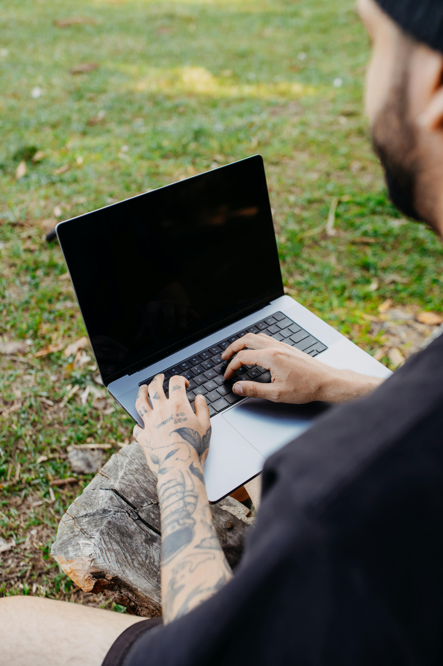
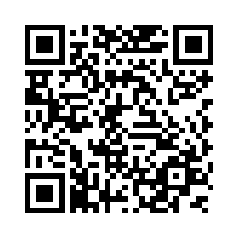
Call to action: Fill out survey
www.bit.ly/SurveyBelgicaWeb

