Slide 1
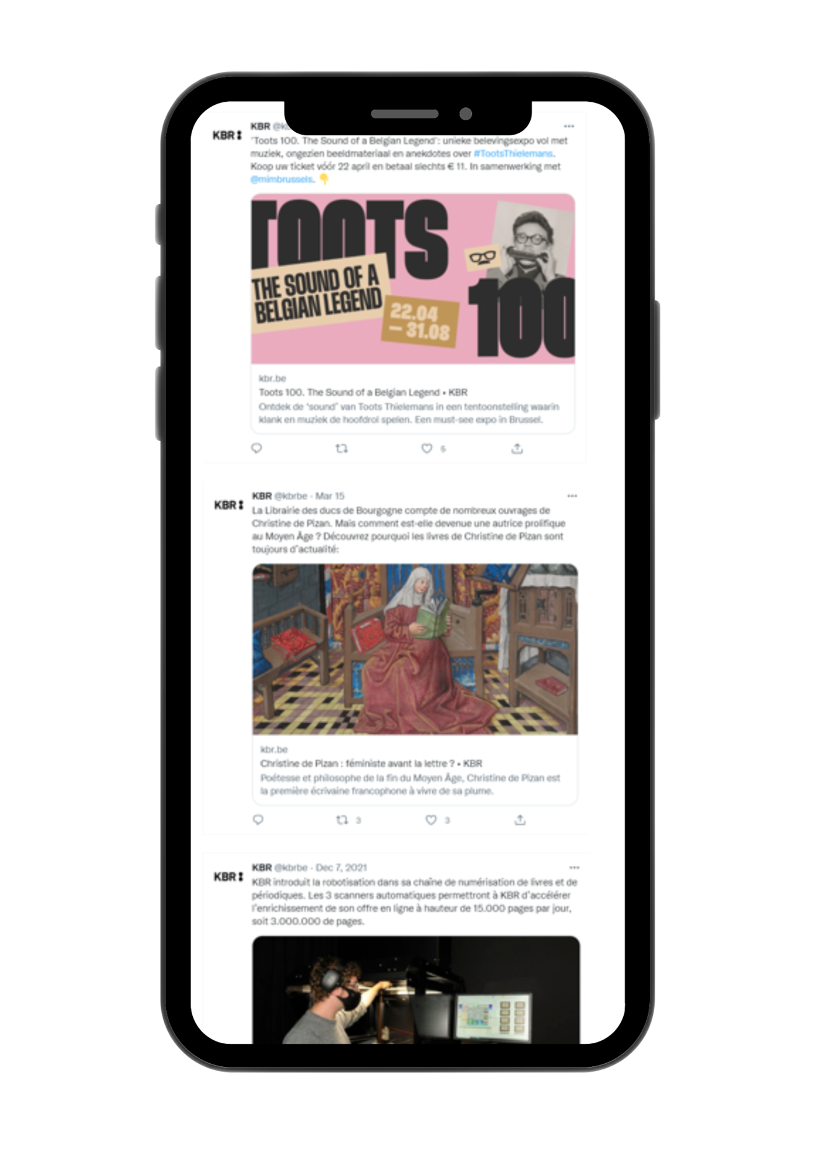
Opening up Born-digital Data for Researchers
Friedel Geeraert | KBR
Christina Vandendyck | KBR
Peter Mechant | imec-mict-UGent
Eveline Vlassenroot | imec-mict-UGent
Yu Tao | intern imec-mict-UGent
4th of June 2024
DH Benelux workshop
Leuven, Belgium

Slide 2
Agenda
Getting familiar
Introduction to the BelgicaWeb project
Workshop outline:
                Topic 1: Selection of content
    Topic 2: Access
    Web Archival Literacy
Wrap-up

Slide 3
Housekeeping
Photo permission: We will be taking some pictures during the workshop to capture our time together. Please let us know if you have any concerns or if you prefer not to be in the photo.
Open communication: We encourage everyone to share their thoughts and experiences. Remember, there are no wrong answers here. Every comment is valued, and we appreciate your contributions. Please make sure to listen respectfully when others are speaking.
Stay engaged: Active participation is encouraged, and we want everyone to get the most out of today.
Breaks: We will have a short break throughout the workshop, so you’ll have time to stretch your legs and grab a drink.
Questionnaire completion: At the end of the workshop, please take a moment to fill out the paper questionnaire. Your feedback is invaluable.

Slide 4
GETTING FAMILIAR
Notes:
Let’s do the introduction first

Slide 5

Who uses born-digital content for their research?
Image from cottonbro studio (Pexels)

Slide 6
Have you ever used a web and/or social media archive?
Image from cottonbro studio (Pexels)

Slide 7

ROUND TABLE
Who are you, and what inspired you to join today's workshop?
Image from Maria Tyutina (Pexels)

Slide 8
INTRODUCTION
Notes:
Let’s do the introduction first

Slide 9

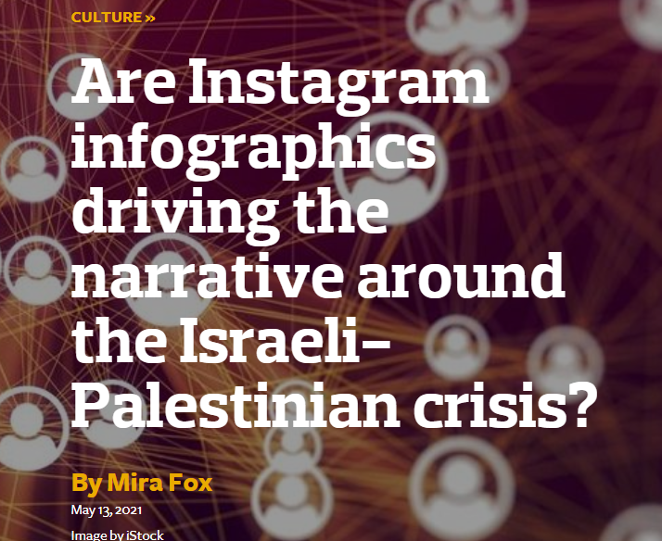

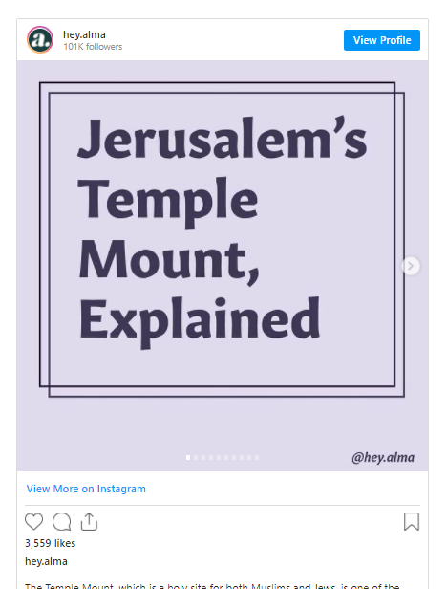
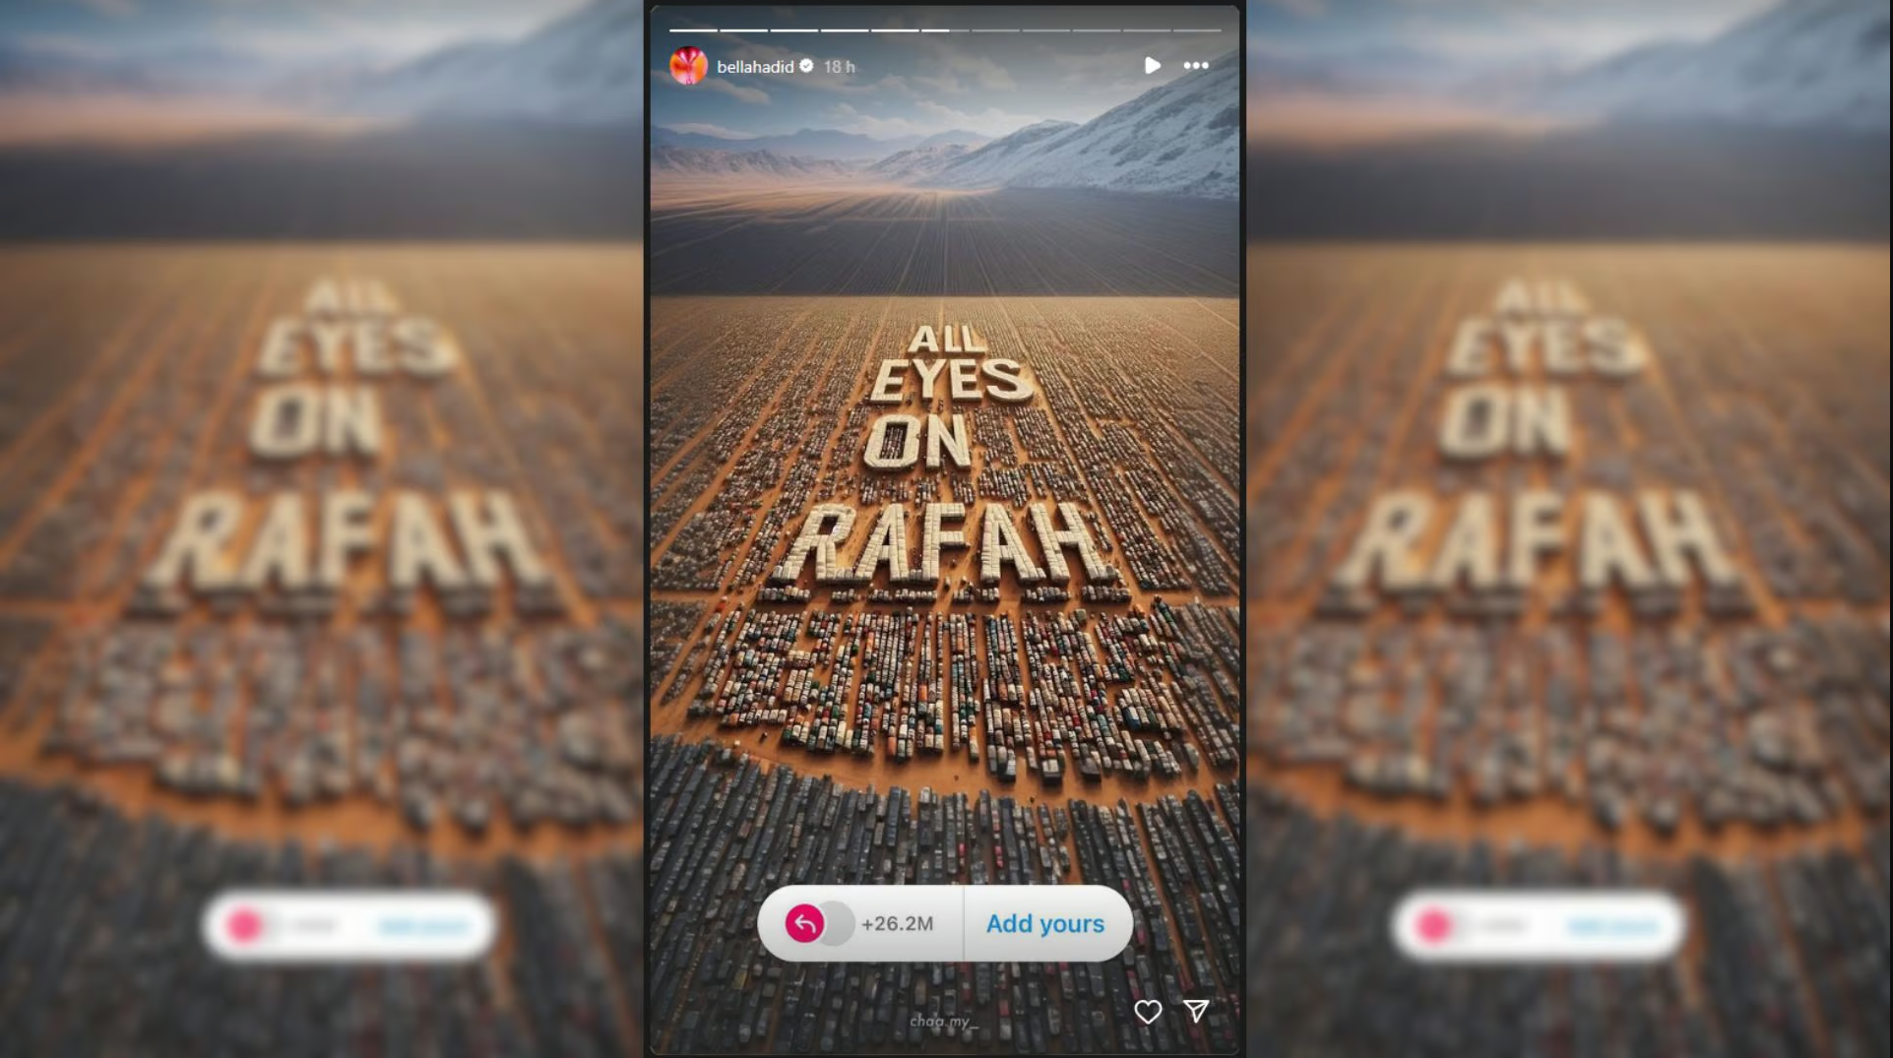
RELEVANCE OF THE WEB TODAY

Slide 10
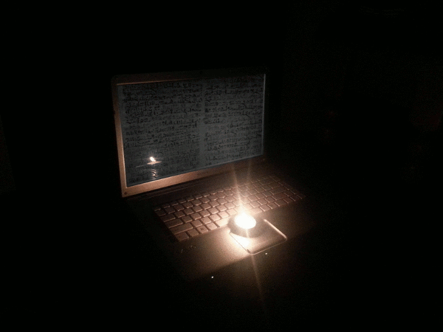






CHALLENGE: REUSE OF EPHEMERAL DATA
Gif via giphy.com
Icons made by Vectors Market & Pixel Market from www.flaticon.com

Slide 11
NATIONAL WEB ARCHIVES SINCE 1996...
1996
Australia: PANDORA
UK Government web archive
1999
New Zealand web archive
2001
Norwegian web archive
1997
Sweden: Kulturarw3
2000
USA: Library of Congress web archive
Czech Republic: Webarchiv
2002
France: BnF web archive

Slide 12
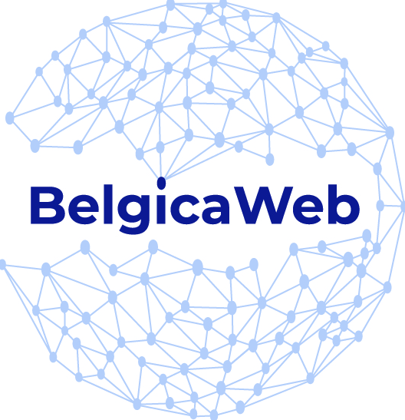
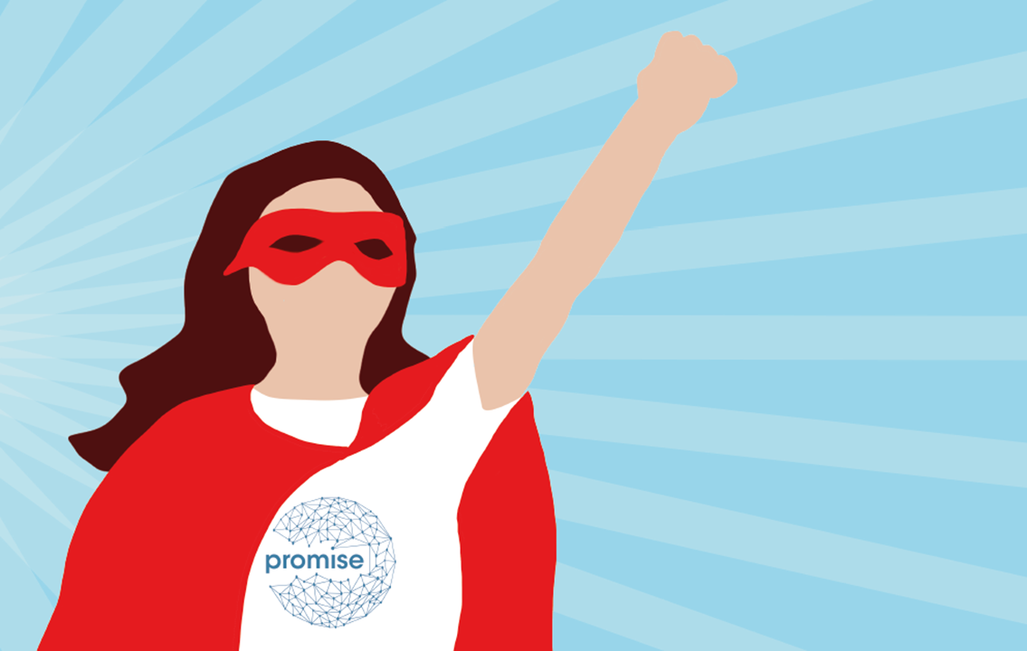

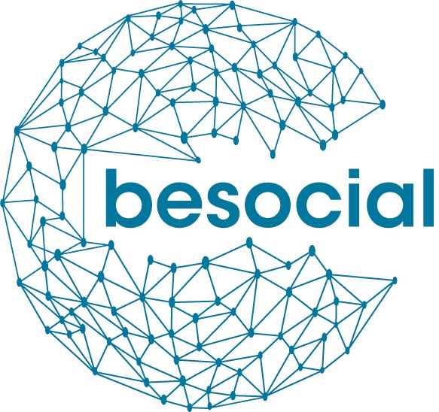
… BUT WHAT ABOUT BELGIUM?
2017 – 2019
Focus on
archiving websites
2020-2022
Focus on
social media
archiving
2024-2026
Focus on
opening up Belgium's born-digital heritage

Slide 13
THE BELGICAWEB PROJECT
3-year research project funded by BRAIN-be (BELSPO): pillar 2 heritage science
Aim: Open up Belgium’s born-digital heritage and make it FAIR
Objectives
  Investigate how to sustainably provide access to these collections
  Develop the necessary data infrastructure
  Enrich the (meta)data via linked data, NLP or other digital methods
  Analyse the relevant legal frameworks
  Promote Belgium’s born-digital heritage

Slide 14





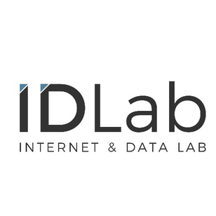

THE BELGICAWEB TEAM
Friedel Geeraert | KBR
Christina Vandendyck | KBR
Alejandra Michel | UNamur (CRIDS)
Cécile de Terwangne | UNamur (CRIDS)
Peter Mechant | UGhent (MICT)
Eveline Vlassenroot | UGhent (MICT)
Dieter Dewitte | UGhent (IDLab)
Fien Messens (ad interim) | UGhent (GhentCDH)
Julie M. Birkholz | KBR and UGhent (GhentCDH)

Slide 15
Workshop outline
Notes:
Let’s do the introduction first

Slide 16
GOAL OF TODAY'S WORKSHOP
Enhance scientific exploitation: Develop strategies to improve access and use of born-digital archived (social media) content
Promote social valorisation: Foster interdisciplinary exchanges to expand the societal benefits of utilising born-digital archives.
=> Gain insights and understand the needs and requirements of researchers for selection, access and use of born-digital archived (social media) content.

Slide 17
WORKSHOP
Introduction to BESOCIAL personas
Introduction to topics (Selection - Access)
Instructions for workshop

Slide 18
INTRODUCTION – Gain insights into user requirements
Personas are fictional characters, created based upon research in order to represent the different user types that might use a service, product, … in a similar way. Creating personas helps us to understand users’ needs, experiences, behaviors and goals.
Are there existing personas for access and use of born-digital archived (social media) content?
Notes:
How can we gain insights and understand the needs and requirements of researchers for access and use of born-digital archived (social media) content?

Slide 19
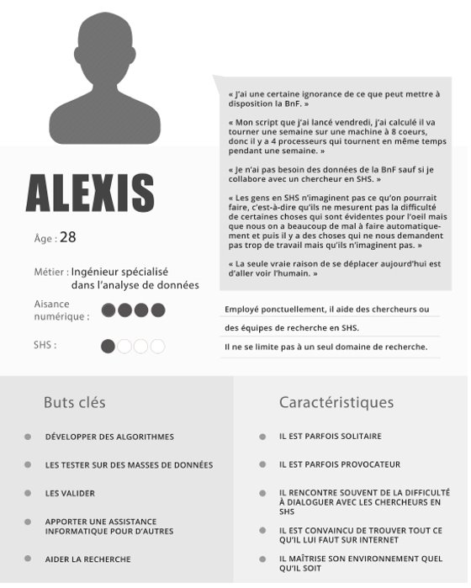
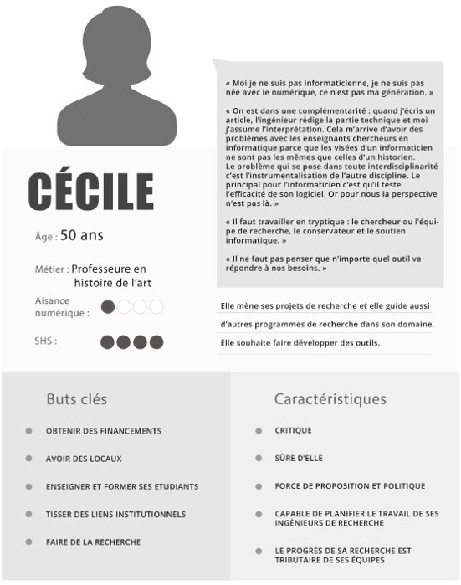
Example 1: Corpus project (BnF)
‘Le projet Corpus et ses publics potentiels. : Une étude prospective sur les besoins et les attentes des futurs usagers’ (https://hal-bnf.archives-ouvertes.fr/hal-01739730/document)

Slide 20
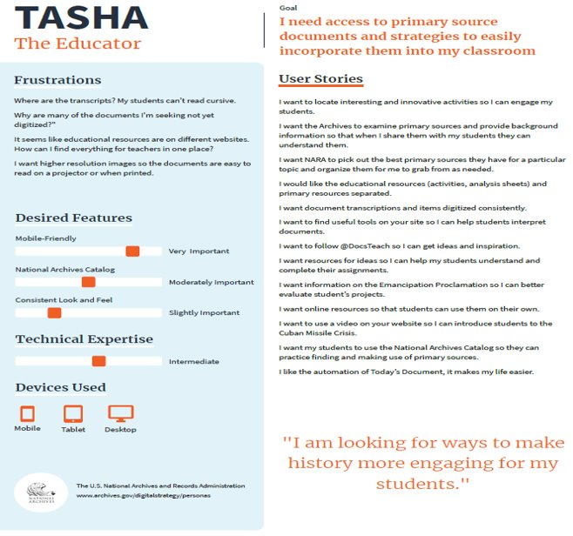
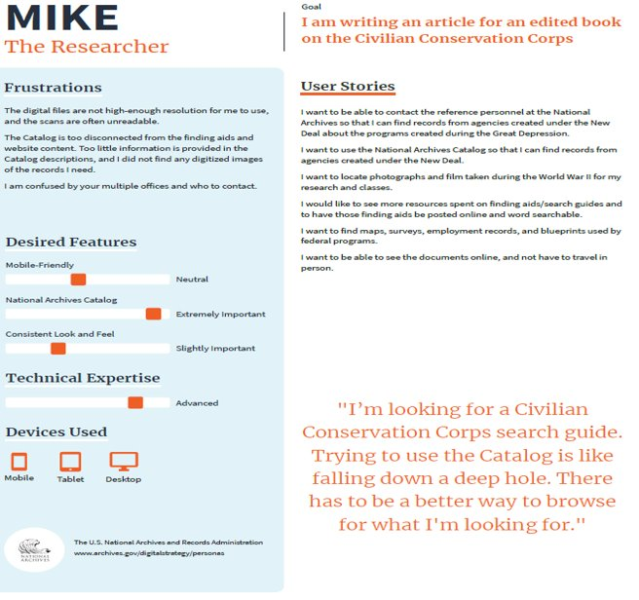
Example 2: US National Archives
Personas created to establish a more robust and data informed understanding of the individuals that engage digitally with the collections @US National Archives (https://www.archives.gov/digitalstrategy/personas).

Slide 21
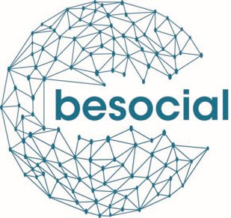





Example 3: BESOCIAL
Bart
Febe
Ben
Manou
Jan
post-doc researcher in communication sciences
PhD-student in computational linguistics
35-year old journalist working for the newspaper
28-year old scientific researcher @KBR
68-year old former team coordinator
Personas created based on in-depth interviews and survey data (n=399, see https://bit.ly/dashboardPROMISEBESOCIAL for interactive Tableau dashboard) within the context of Belspo funded project PROMISE & BESOCIAL (2020-2022).

Slide 22
Persona #1: Bart
Age & Profession:
42-year old post-doc researcher in communication sciences
Goal for using social media archive:
His abstract got accepted and now he and his assistant need to urgently start researching the hypothesis that ‘more extreme political parties post more ‘populist’ content/messages on Twitter’. In order to do that they need the tweets of all Belgian political parties tweeted over the last year.
Professional situation: Although Bart has some programming expertise, acquired more than a decade ago, he feels that he is not up to date. Moreover, because of a heavy workload, he feels that he lacks the time to thoroughly learn/acquire new skills that are required. He has little to no expertise in working with big data nor expertise in working with analytical software that can process those big datasets.

Slide 23
Persona #2: Febe
Age & Profession:
24-year old PhD-student in computational linguistics
Goal for using social media archive: Febe is trying to develop a methodology for sentiment analysis and subjectivity detection through the deep semantic analysis of text published via social media channels. In order to train and test her code, she is looking for a big data set with (textual) social media content.
Professional situation: In her first year, colleagues with more expertise helped her a lot with mastering the programming techniques and analytical software that are key in her field. This year she is following dedicated courses that focus on advanced programming through the high-performance computer cluster that her university makes available.

Slide 24
Persona #3: Ben
Age & Profession:
a 35-year old journalist working for a newspaper
Goal for using social media archive: For an article on ‘fake news’ Ben needs to collect examples of fake news (posts) on social media that were posted in the past.
Professional situation: Ben is known for his resourcefulness and for the fact that he likes to tinker with technology and software. However, Ben has never had a formal education in programming languages or techniques, nor does he have expertise in working with big data or analytical software.

Slide 25
Persona #4: Manou
Age & Profession:
28-year old scientific researcher @ national library
Goal of using social media archive: Manou wants to conduct exploratory research by means of close reading of pertinent social media channels and accounts to see whether social media comments exist on digitised heritage collections. In order to kick-off the collection she aims to collect as much as social media content as possible on already digitised heritage collections.
Professional situation: Manou studied information and communication sciences (during which she picked up some basic digital literacy skills).

Slide 26
Persona #5: Jan
Age & Profession:
68-year old former team coordinator at a car manufacturer, now retired.
Goal of using social media archive: Jan regularly writes blog posts for the website of the Belgian China-Belgium club. For one of these blog posts, he would like to elaborate on how China is described and framed in Belgium, in particular on how China is portrayed on Belgian social media and how this discourse evolved over time. In order to do this, he needs all Belgian social media content about China he can get his hands on.
Professional situation: Jan used to be a team leader at a car manufacturer. For this job, he had to regularly travel to China. Jan has no programming expertise, nor is he acquainted with big datasets or analytical software.

Slide 27
Can you identify with one (or more) of the personas?
Image from cottonbro studio (Pexels)

Slide 28
Overview personas
Bart
Febe
Ben
Manou
Jan
post-doc researcher in communication sciences
PhD-student in computational linguistics
35-year old journalist working for the newspaper
28-year old scientific researcher @KBR
68-year old former team coordinator
Goal: Investigate if more extreme political parties post more populist content on Twitter, needing tweets from all Belgian political parties over the last year.
Professional Situation:
Outdated programming skills
Lacks current expertise in big data and analytical software
Heavy workload
A lack of time to acquire new skills
Goal: Develop methodologies for sentiment analysis and subjectivity detection through deep semantic analysis of social media texts, requiring a large dataset of textual social media content.
Professional Situation:
In the process of mastering advanced programming techniques through dedicated courses and access to high-performance computing, enhancing her capabilities in handling large datasets
Goal: Collect examples of fake news on social media for an article, needing historical posts that contain fake news.
Professional Situation:
Known for his resourcefulness and affinity for tinkering with technology and software
Lacks formal education in programming and expertise with big data or analytical tools.
Goal: Conduct exploratory research on social media comments related to digitized heritage collections, aiming to collect as much relevant social media content as possible.
Professional Situation:
Has basic digital literacy skills from her studies in information and communication sciences
Limited advanced digital capabilities.
Goal: Write about how China is portrayed in Belgian social media over time, requiring comprehensive data on all Belgian social media content about China.
Professional Situation:
Lacks programming expertise
Not familiar with big datasets or analytical software
Relying on basic tools and potentially needing assistance for complex data handling.

Slide 29
3. Workshop instructions
Pick and personify with a BESOCIAL persona
Join the designated group working with the same BESOCIAL persona (ideally a diversity of personas)
3. Now imagine that you are this persona with his or her interests, skills and expertise
4. As a group, pick a (social media) web archive with online accessibility that the group will use as a use case:
  The institution you are working for, or
  A best-practice example in your opinion, or
  A web archive from the list (see list shared upfront)
5. Two topics will be presented (selection – access) (10min)
6. Discuss this topic as described for the persona you did chose for the (social media) web archive you picked following this timeline (total of 30min):
  Individually, take 5 minutes to visit the archive and write down hurdles or challenges for that topic on post-its
  Group & discuss post its in small group (max. 10 minutes)
  Individually, take 5 minutes to answer the ‘How might we solve this?’-question for the identified hurdles or challenges
  Group & discuss ‘How might we solve this? post its in group (max. 10 minutes)
7. Reconvene for wrap-up

Slide 30
Topic 1: Selection
Researcher needs in terms of content selection and implementation
Notes:
Let’s do the introduction first

Slide 31
What is selection in Web & Social media archiving?
Definition:
the selection of specific web & social media resources for collection (Vilar, P. 2008).
A collection of web/social media-published materials that an institution has either made arrangements for or has accepted long-term responsibility for preservation and access in keeping with an archive's user access policies (Bingham, Byrne, & Hoggarth, 2018).
A model process for making selection decisions, the context in which selection decisions must be taken, possible approaches to selection, selection criteria and the elements required to create a selection list (Vilar, P. 2008).
Related words: Collecting/ Harvesting/Crawling/ Scraping
Related document: Collection policy
Notes:
Internationally the following common trends were identified: i) Twitter is the social media platform most often archived; ii) collections of accounts and/or hashtags focus on important people, organisations, and events; iii) priority is given to selective harvests
On a Belgian level we concluded that Facebook is most often archived, followed by Twitter and Instagram. This preference is driven by the thematic aspect; organisations find that the accounts they want to capture are more likely to be found on Facebook. We also notified that the number of accounts and/or hashtags is well balanced between the number of social media platforms. In case that one wishes to archive a lot of accounts and hashtags, organisations opt for fewer platforms. Our findings showed that most of the harvesting is executed by means of open source tools with a focus on capturing the look and feel of an account.

Slide 32
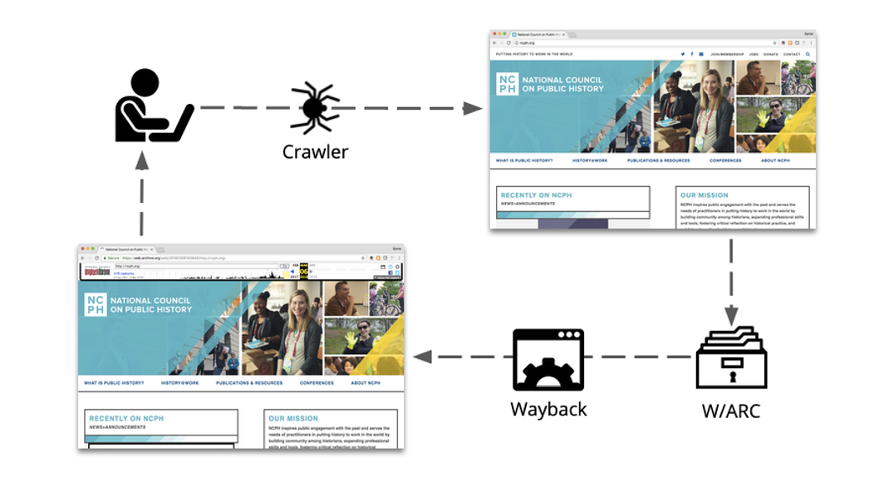
Figure 1. What is web archiving? From Archive-It Help Center. Retrieved from https://support.archive-it.org/hc/en-us/articles/360041674111-What-is-web-archiving/.
Notes:
Internationally the following common trends were identified: i) Twitter is the social media platform most often archived; ii) collections of accounts and/or hashtags focus on important people, organisations, and events; iii) priority is given to selective harvests
On a Belgian level we concluded that Facebook is most often archived, followed by Twitter and Instagram. This preference is driven by the thematic aspect; organisations find that the accounts they want to capture are more likely to be found on Facebook. We also notified that the number of accounts and/or hashtags is well balanced between the number of social media platforms. In case that one wishes to archive a lot of accounts and hashtags, organisations opt for fewer platforms. Our findings showed that most of the harvesting is executed by means of open source tools with a focus on capturing the look and feel of an account.

Slide 33
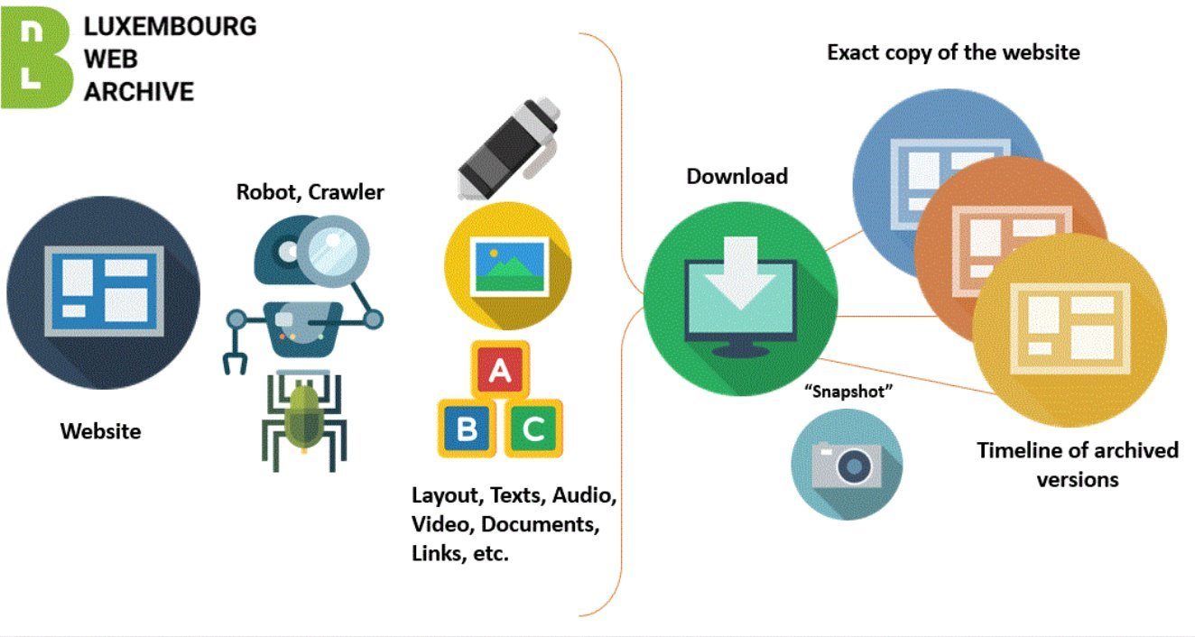
Figure 2. The process. From Bibliothèque nationale (BnL). Retrieved from https://www.webarchive.lu/how-it-works/.

Slide 34

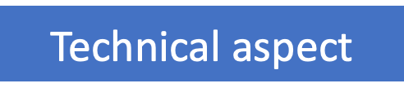

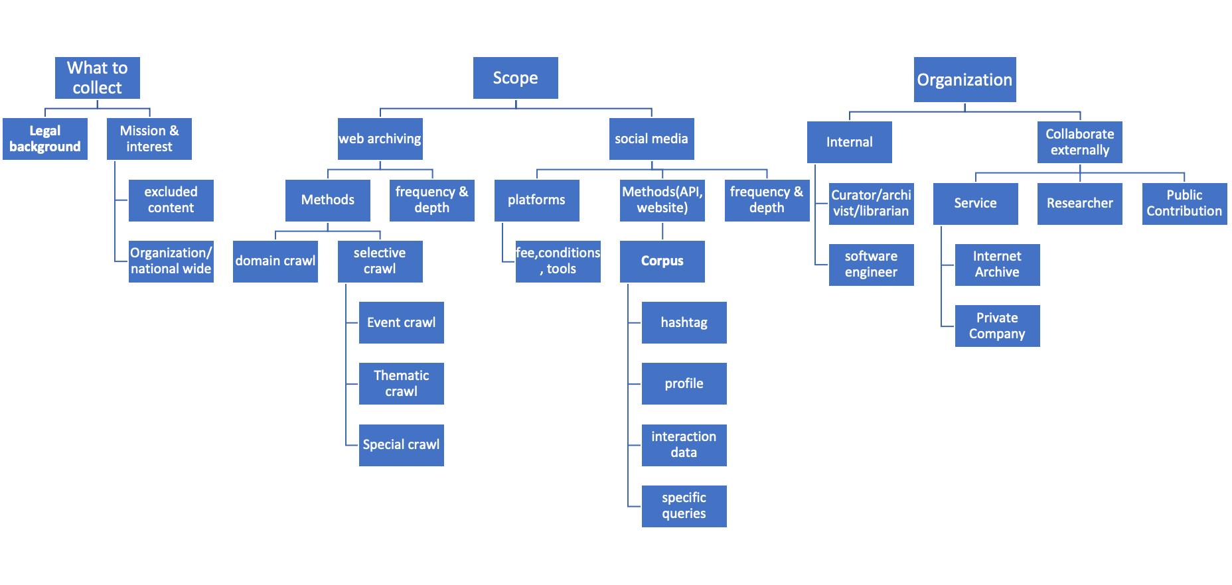
Crucial Elements for Consideration

Slide 35
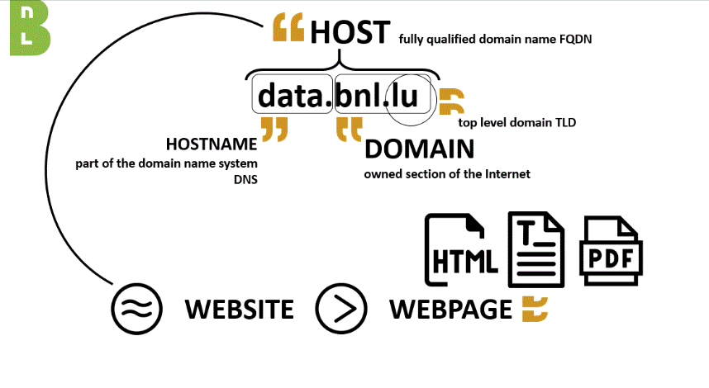
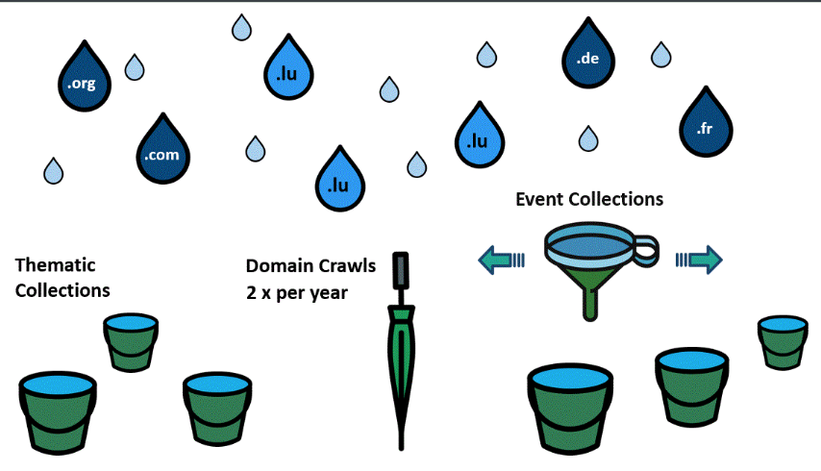
Different crawl methods
Unselective method: take a conscious decision not to select, collecting everything possible.
Domain crawls: capture snapshots of numerous seeds across all domains, e.g, .lu/.dk at different times of the year.
Selective method: identifies specific web resources for collection.
Thematic or event collections: target specific topics or events with more frequent captures of fewer seeds, based on subject matter.
Figure 3&4. How it works. From Bibliothèque nationale (BnL). Retrieved from https://www.webarchive.lu/how-it-works/.​

Slide 36
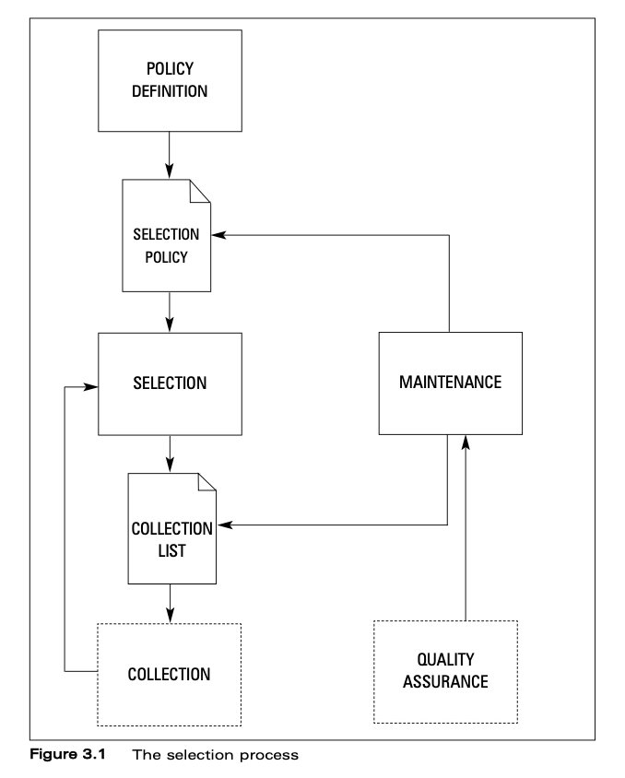
Figure 5. The Selection process. Vilar, P. (2008). Archiving Websites: A Practical Guide for Information Management Professionals.

Slide 37
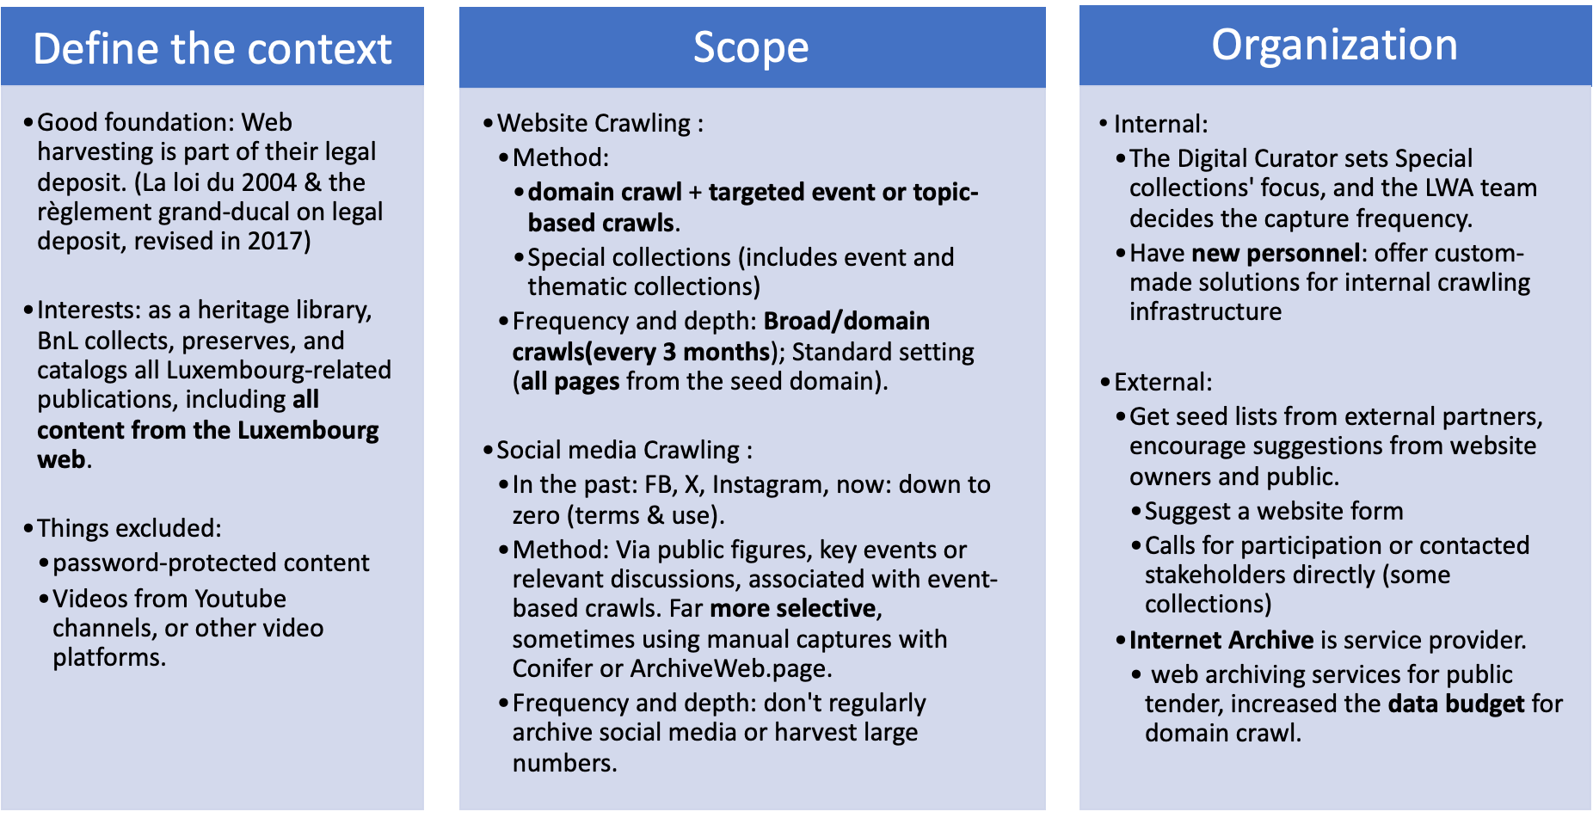
How do institutions handle this? (user case BnL)

Slide 38
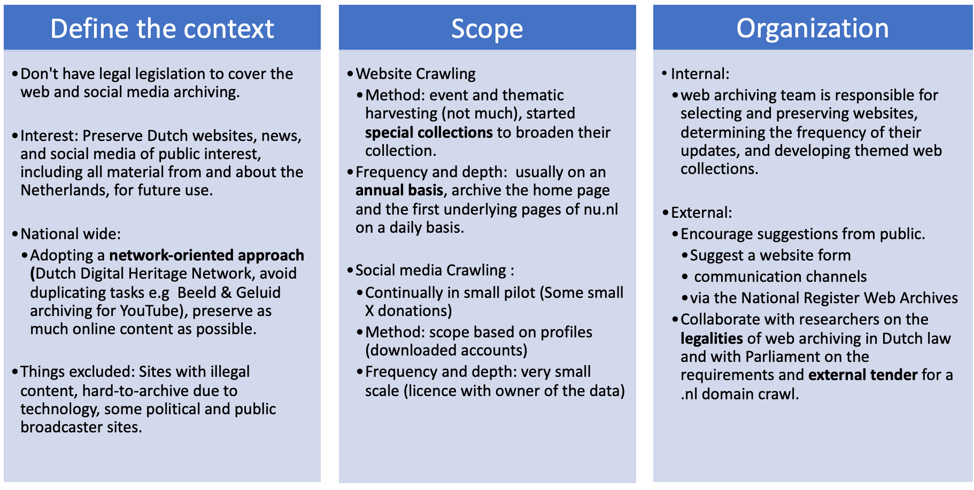
How do institutions handle this? (user case KB)

Slide 39
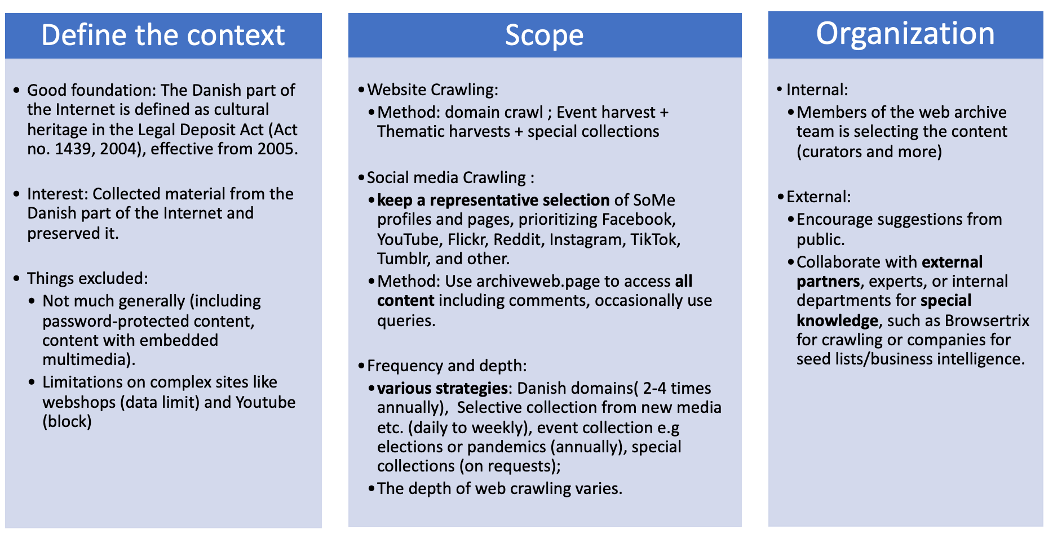
How do institutions handle this? (user case Netarkivet)

Slide 40
Reference
Vilar, P. (2008). Archiving Websites: A Practical Guide for Information Management Professionals. Journal of Documentation, 64(2), 304-305
Bingham, N., Byrne, H., & Hoggarth, G. (2018). Resource Type: Research report. London, UK: British Library
National Archives of the Netherlands (2018). Guidelines for archiving government websites
Bonnel, S. (2015). Selecting websites in an encyclopaedic national library : a shared collection policy for internet legal deposit at the BnF English.
Aubry, S. (2010). Introducing Web Archives as a New Library Service: the Experience of the National Library of France. The Liber Quarterly, 20, 179-199.
BnL, KB, Netarkivet, desk research and personal research communication, Jan - May, 2024.

Slide 41
Discussion topic 1: Selection (30 min)
According to your persona, what are challenges with regards to selection policy you encounter?
Can you write possible solutions or opportunities for these challenges?
Dialogue initiators:
Born-digital challenges: What makes born-digital content unique?
What is the importance of cultural representativity, public interest, historical value, scientific value?
Crowdsourcing methods: What are methods and strategies to engage researchers in content selection?
Step 1 | Individually | Visit an archive and write down hurdles or challenges for that topic on post-its. | 5 min
Step 2 | In small group | Group & discuss the post-its. | 10 min (max)
Step 3 | Individually | Answer the ‘How might we solve this?’-question for the identified hurdles or challenges. | 5min
Step 4 | In small group | Group & discuss ‘How might we solve this?' post-its. | 10 min (max)
⏲️TIMING
Notes:
For the selection of the BESOCIAL corpus we first started with reviewing how this step was tackled in Belgium and internationally. Overall, we can conclude that the choices and different steps taken in the social media archiving process are resource-dependent.
time to explore SMA next to the ongoing tasks within cultural institutions
(technical) in-house knowledge
limited financial resources to, for example, switch to commercial tools and thereby gaining time.
Legal framework also plays an important role in SMA processes. When it comes to legal considerations that constitute obstacles to the evolution of the digital society, we can say that this evolution has happened at such a fast pace that it has been difficult for the law to keep up with the latest developments.

Slide 42

20 min break
Notes:
20 min break

Slide 43
Topic 2: Access
Researcher needs in terms of access and implementation of (pilot) API and access platform
Notes:
The importance of web and social media archiving is gaining recognition. Efforts are being made to enhance archiving methods, streamline the overall process, and create more collections for public access.

Slide 44
What is access in Web and Social media archiving?
"The ability to retrieve, view, and use archived web and social media content."
Access mechanisms:
Searchable databases and repositories
User-friendly interfaces for easy navigation
Permissions and restrictions:
Controls based on copyright, legal deposit and institutional policies
Tiered access levels for different user groups
Tools:
Use of APIs for data extraction and retrieval
Implementation of content management system

Slide 45
How to access web and social media archives?
Access conditions differ widely between web archives
Some of the web archives are freely accessible online (see examples list)
For web and social media archived hosted by national libraries, this mission is complementary to their national heritage preservation mandate
However, granting such access to the public must comply with the legal provisions related to copyright
Some options for accessing web and social media archived content:
      Only physical access on location (e.g. Public terminals in the reading room)
      Imposed requirements to obtain access (e.g. Paid library cards, only access for research purposes, etc.)
      ...
    Some examples of web archives that are freely accessible online:
    https://tweetsets.library.gwu.edu/datasets
    http://webadmin.oszk.hu/solrwayback/
    http://www.nationalarchives.gov.uk/webarchive/
    https://www.webarchive.lu/covid-19/
    http://data.webarchive.org.uk/opendata/ukwa.ds.2/#issues
    https://netpreserve.org/projects/collaborative-collections/
    https://arquivo.pt/
    https://www.loc.gov/web-archives/collections/
    https://vefsafn.is/en/
    ..
Notes:
Due to legal restrictions and copyright considerations, many archives can only be accessed through the website. However, steps are being taken to improve their public accessibility and variety. These include making the public website freely accessible, enhancing the search function with specific public features, and displaying metadata.

Slide 46
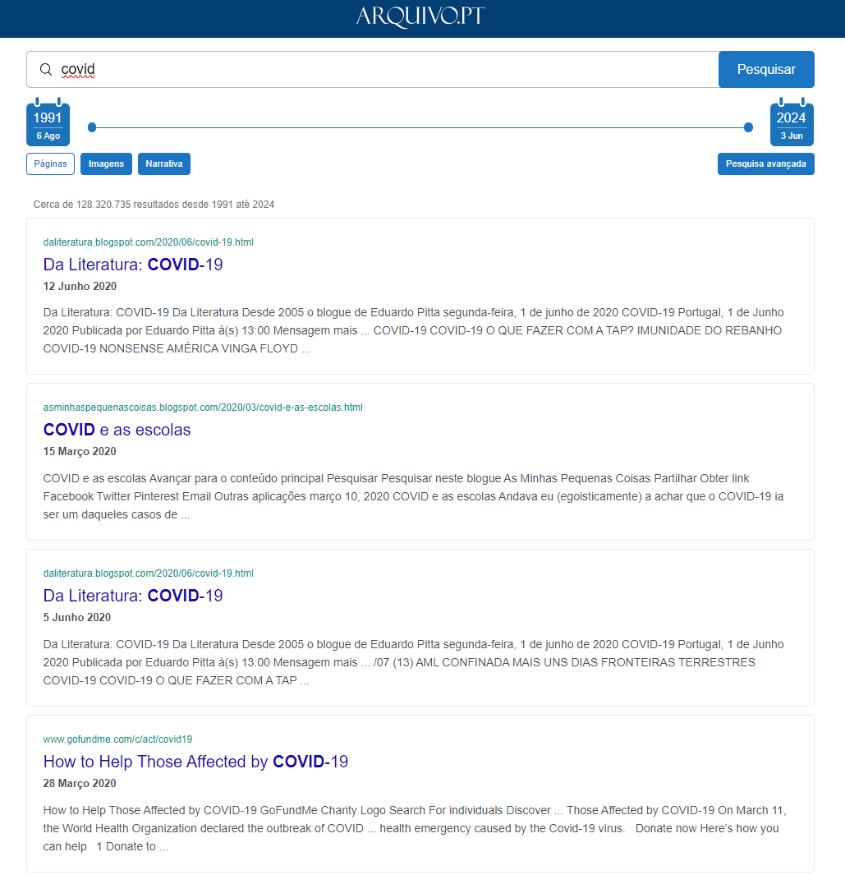
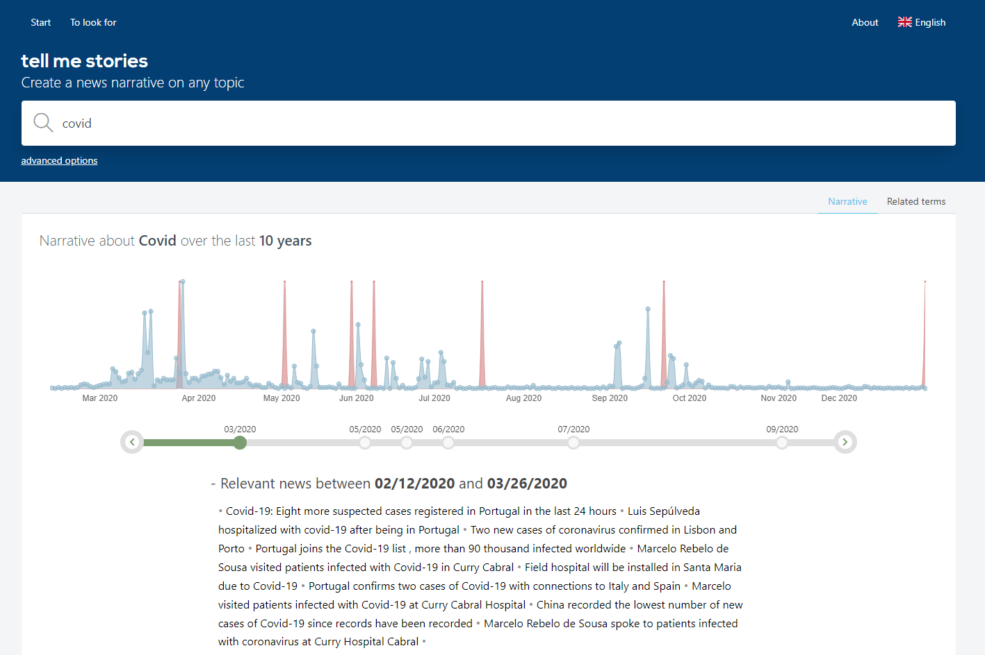
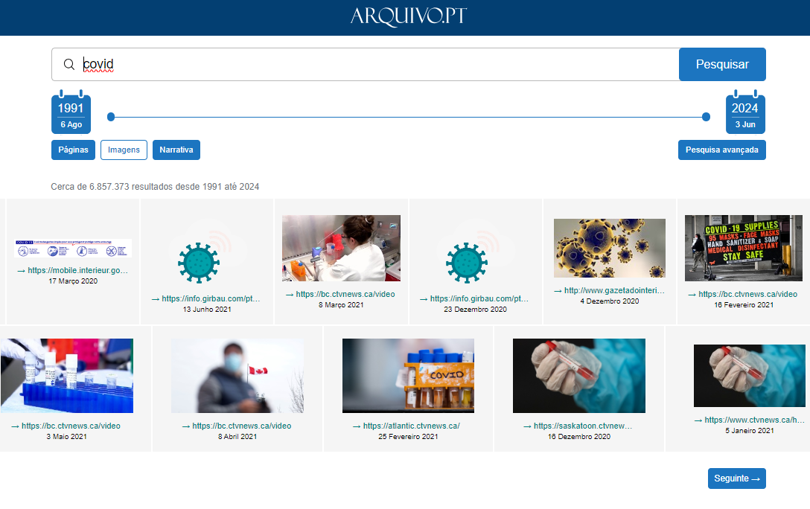
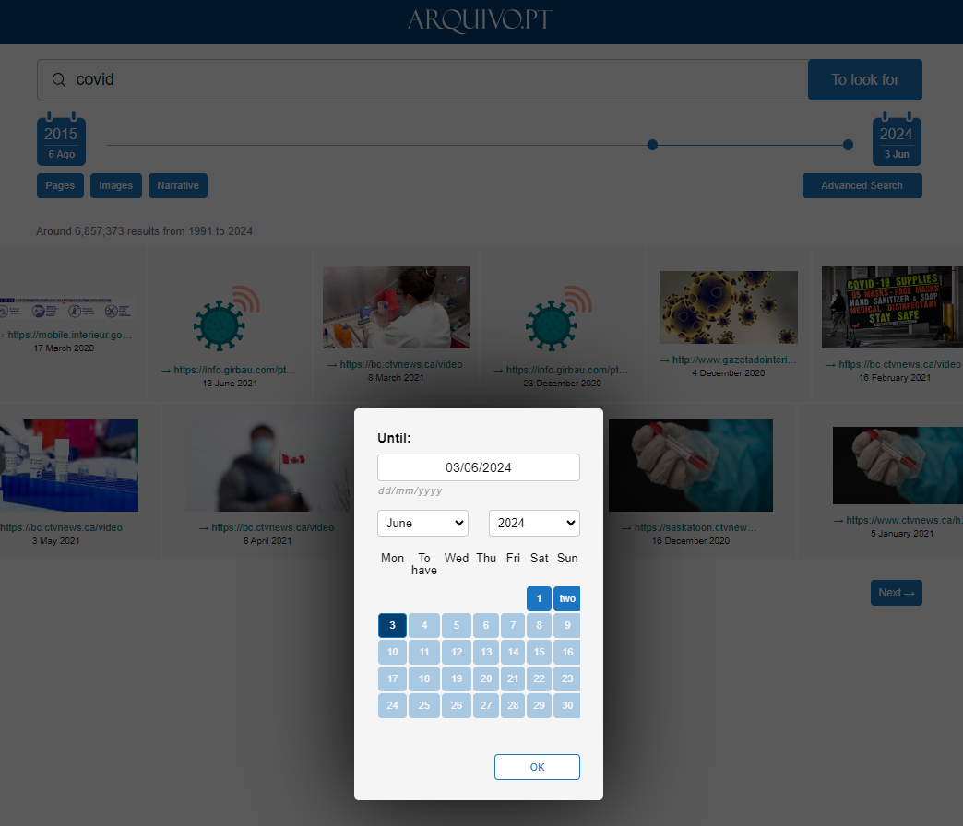
How to give search input? (example Arquivo.pt)
https://arquivo.pt

Slide 47
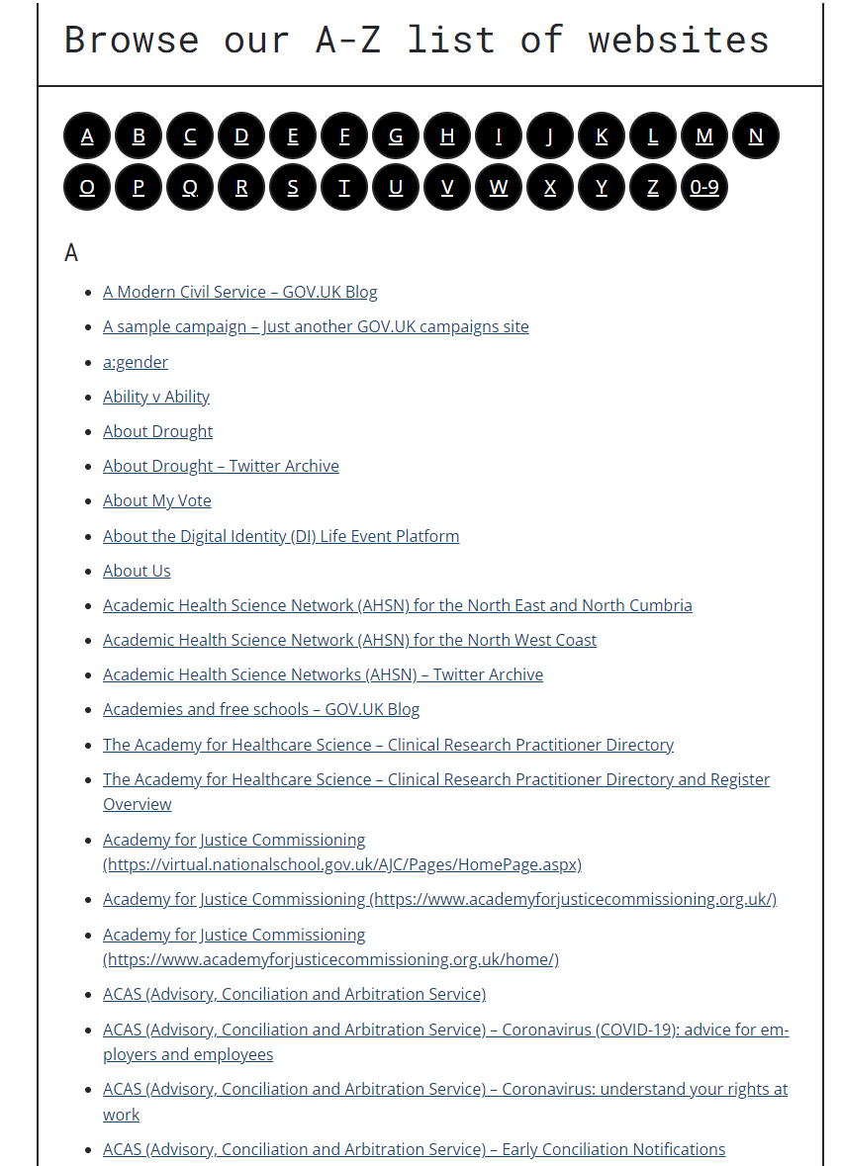
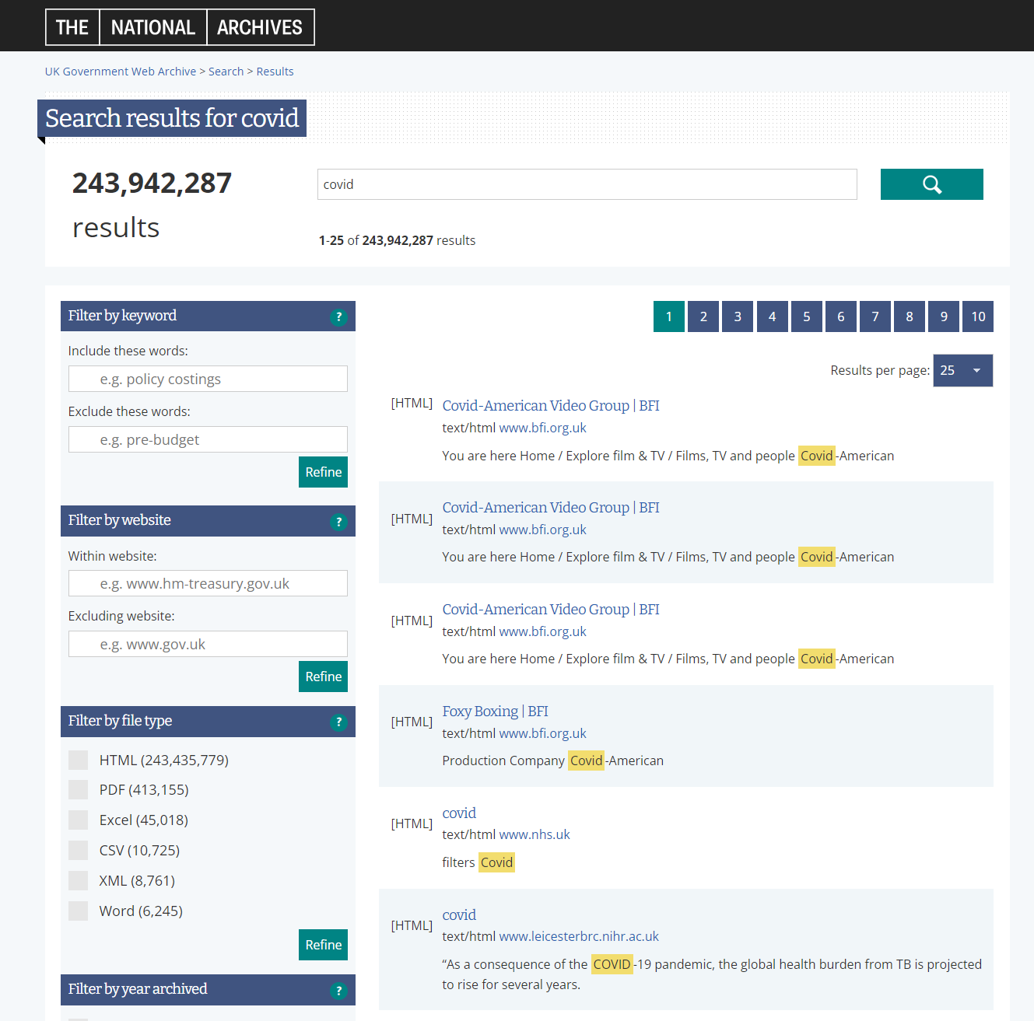
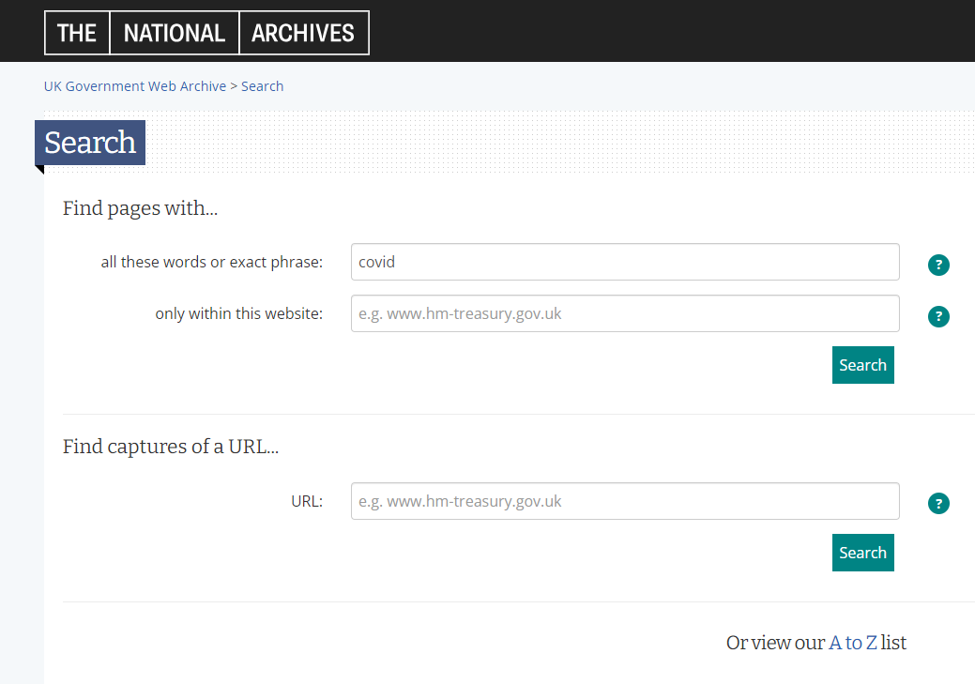
How to give search input? (example National Archives UK)
http://www.nationalarchives.gov.uk/webarchive/

Slide 48
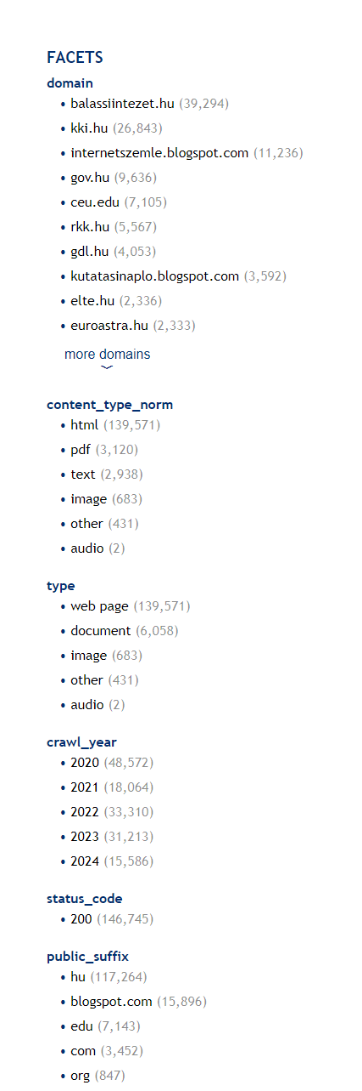
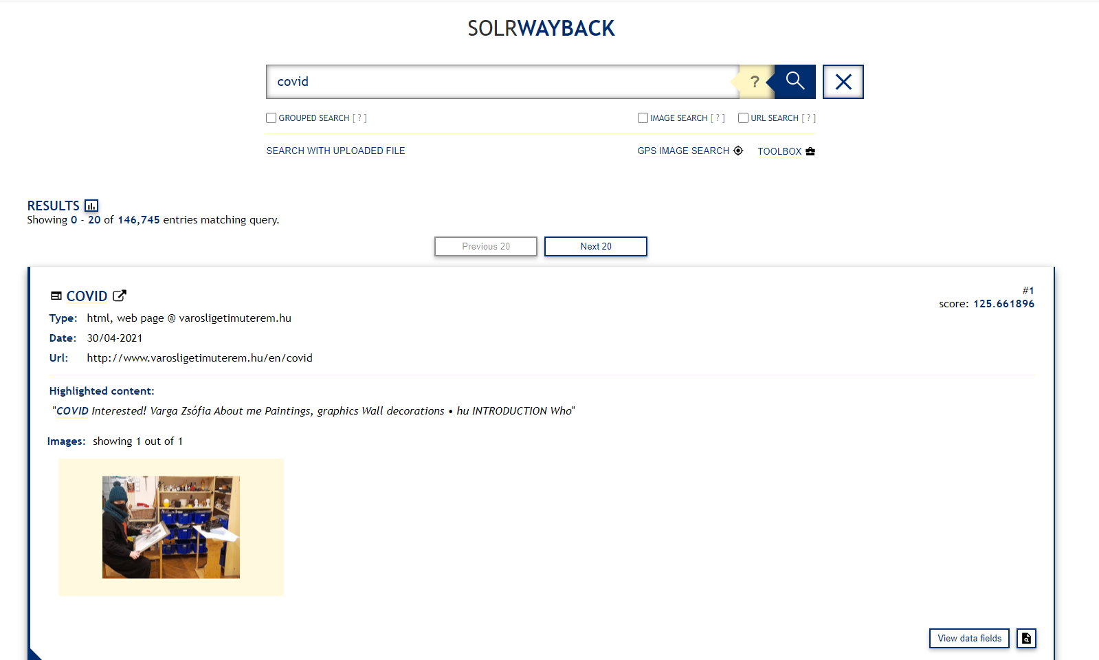
How to give search input? (example National Library Hungary)
https://webadmin.oszk.hu/solrwayback/

Slide 49
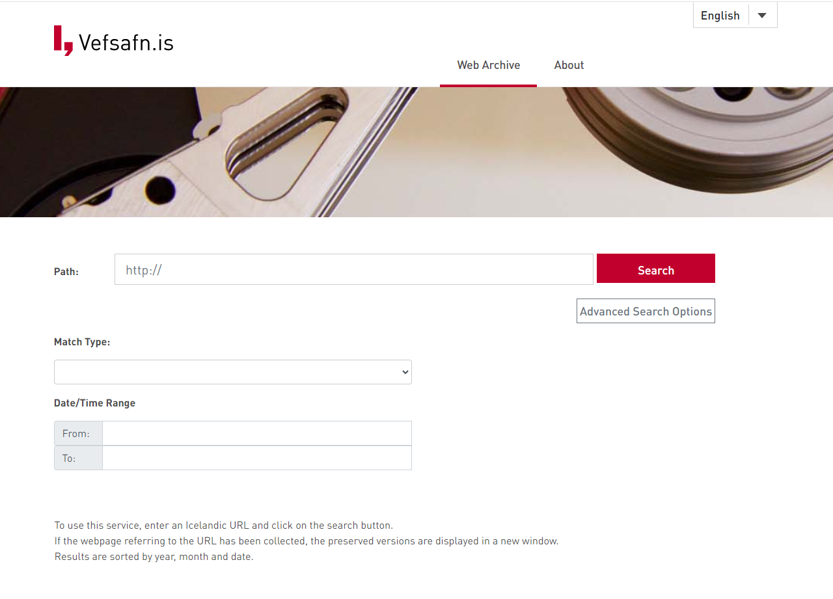
How to give search input? (example Icelandic Web Archive)
https://vefsafn.is/en/

Slide 50
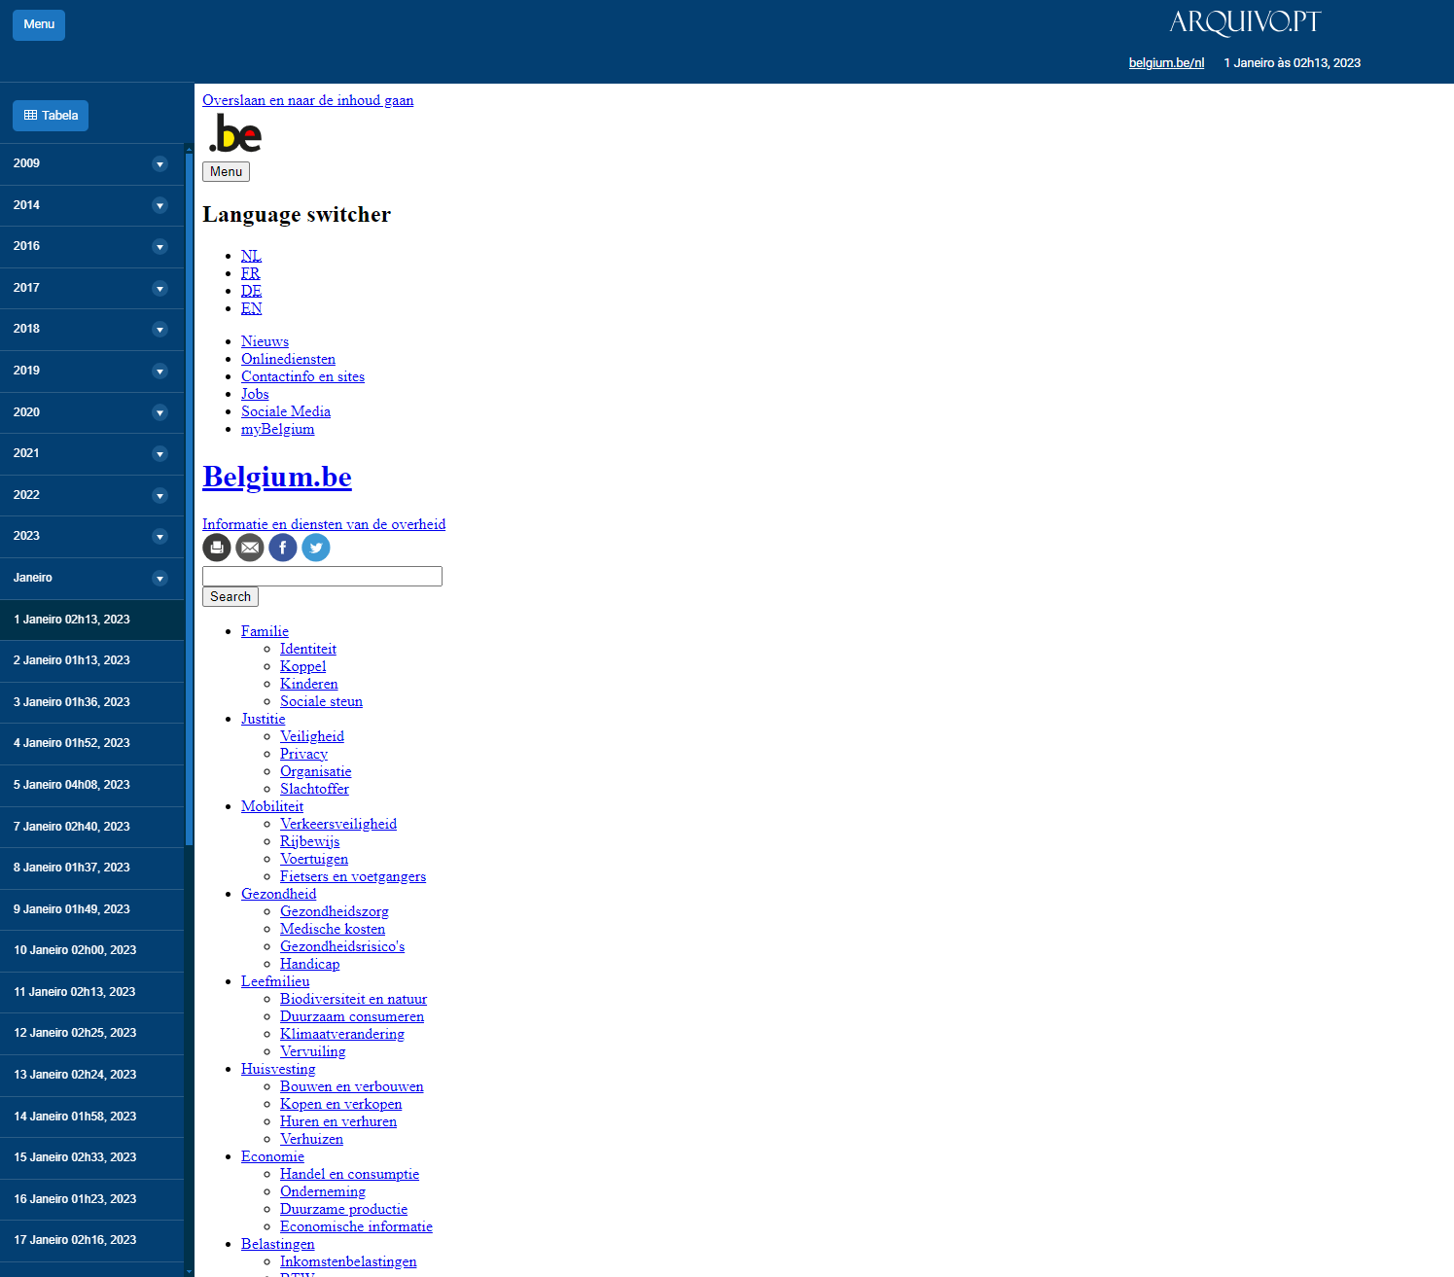
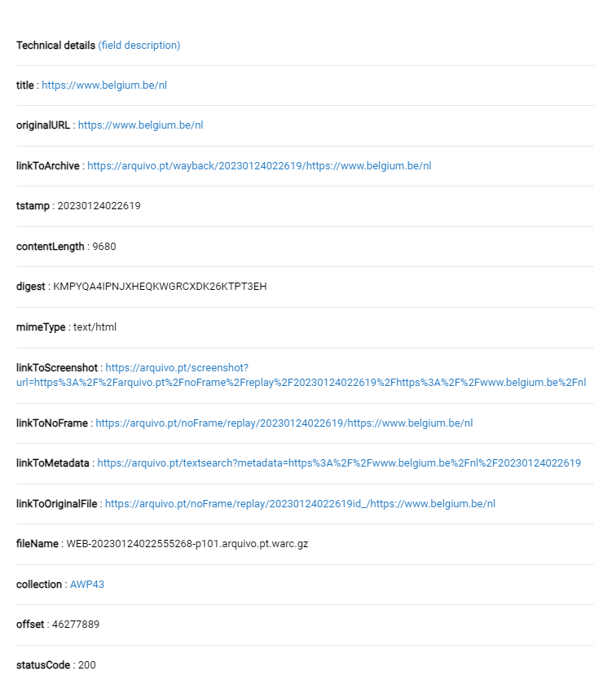
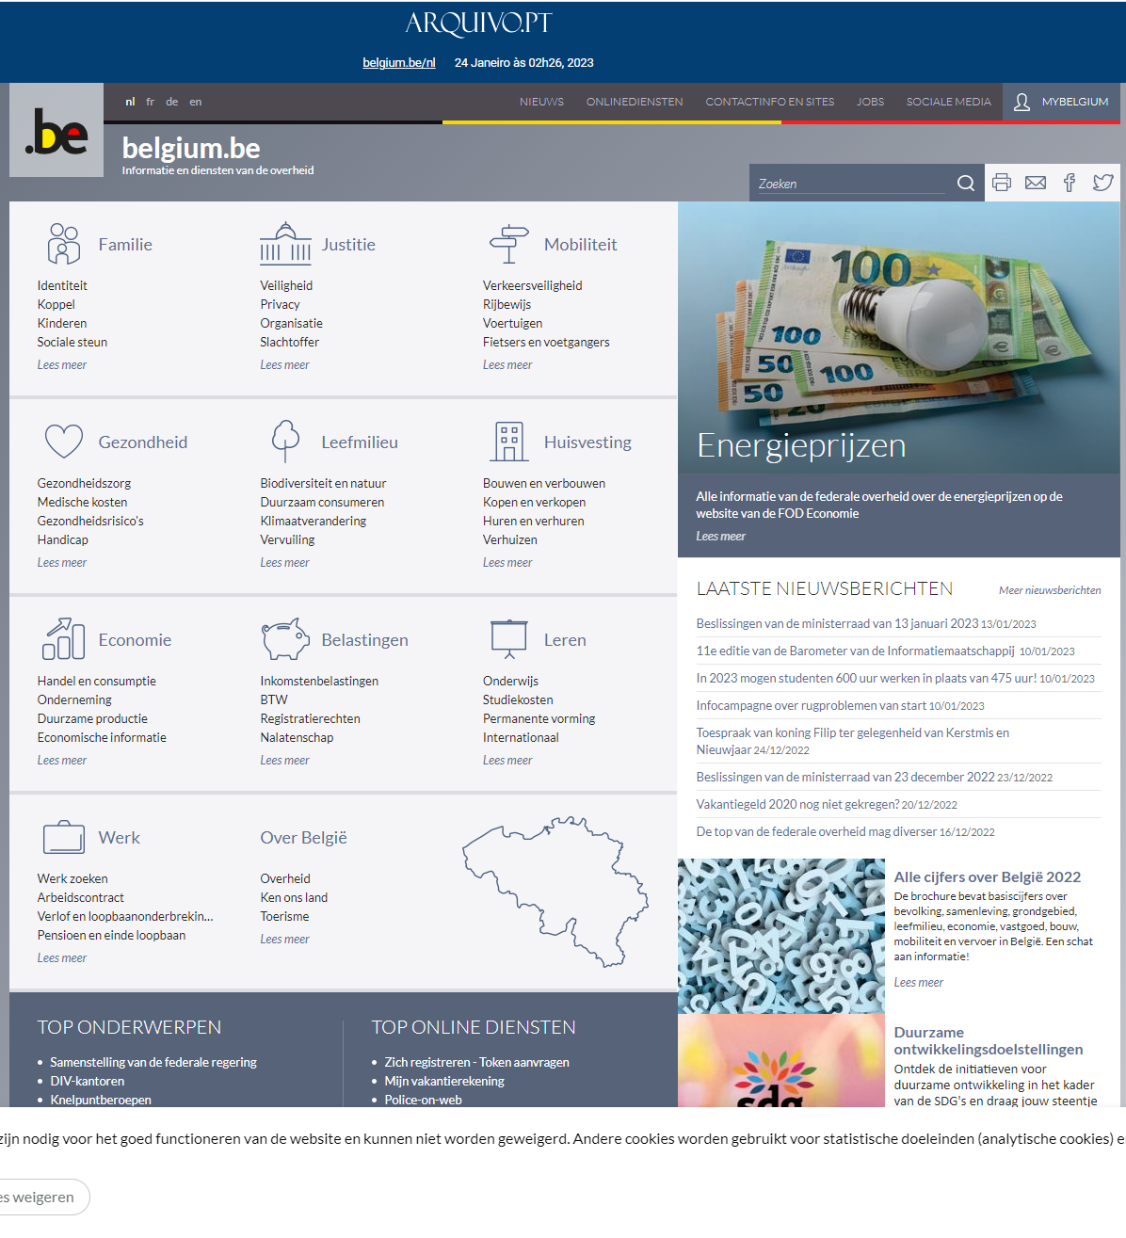
What is the output? (example Arquivo.pt)
https://arquivo.pt

Slide 51
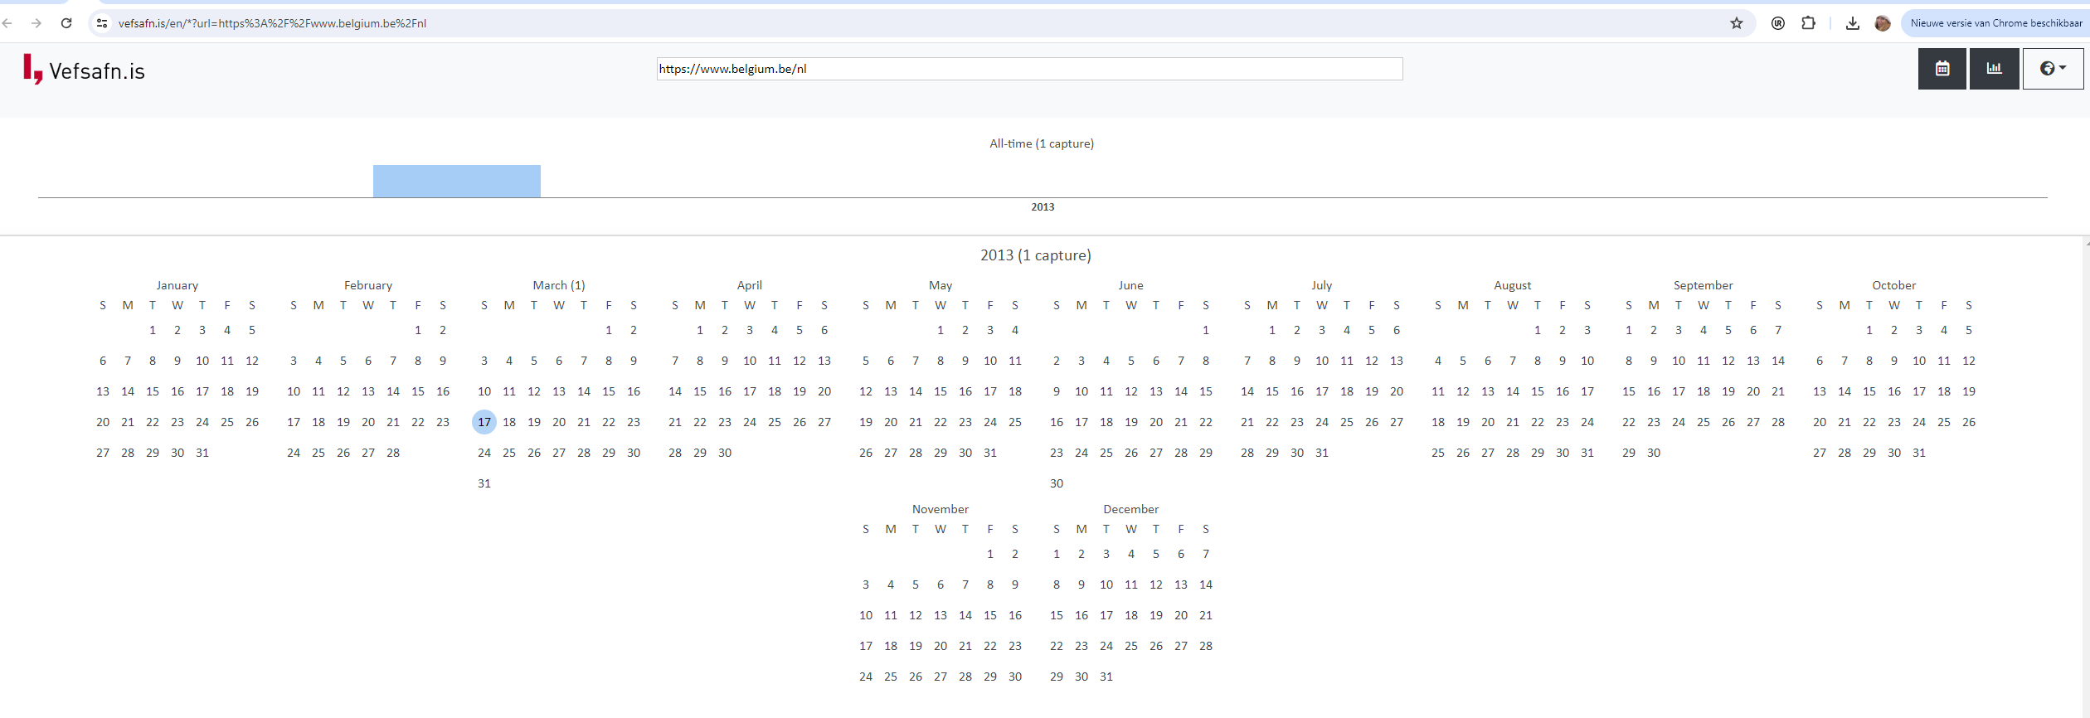
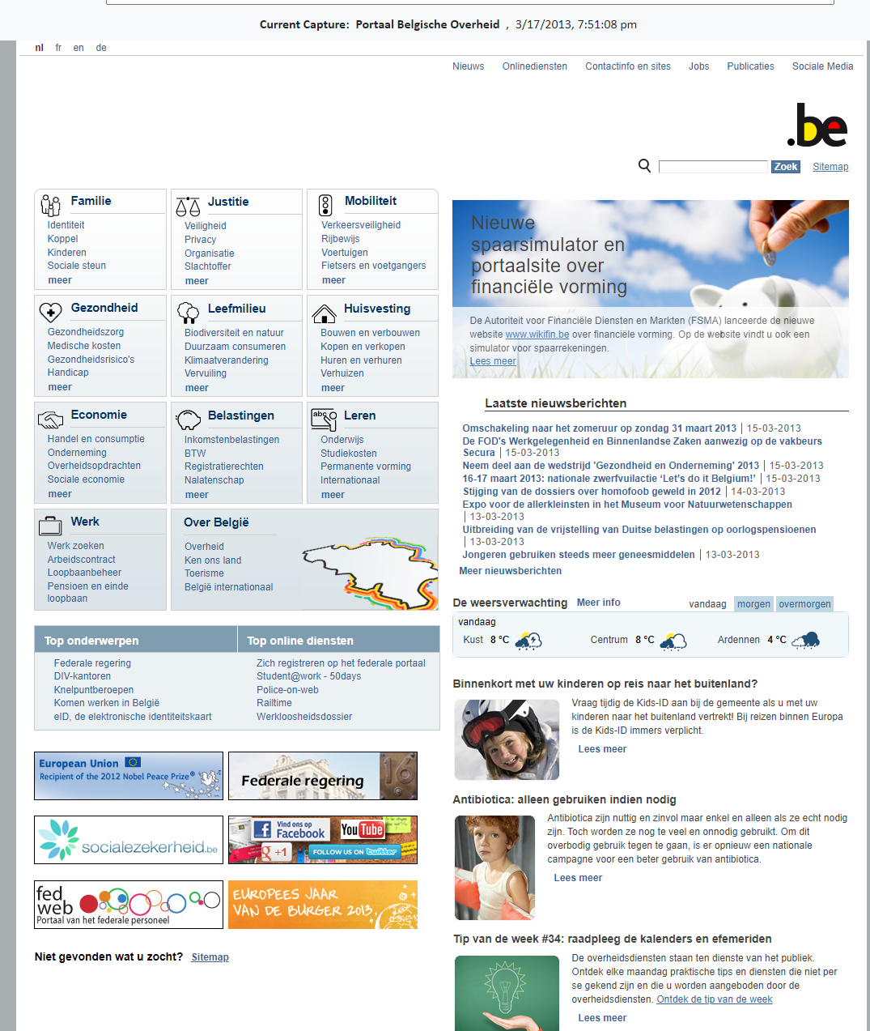
What is the output? (example Icelandic Web Archive)
https://vefsafn.is/en/

Slide 52
Discussion topic 2: Access (30 min)
According to your persona, what are challenges with regards to access you encounter?
Can you write possible solutions or opportunities for these challenges?
Dialogue initiators:
Discuss essential features that enhance user experience, such as capabilities, user interfaces, accessibility options, search output etc.
Step 1 | Individually | Visit an archive and write down hurdles or challenges for that topic on post-its. | 5 min
Step 2 | In small group | Group & discuss the post-its. | 10 min (max)
Step 3 | Individually | Answer the ‘How might we solve this?’-question for the identified hurdles or challenges. | 5 min
Step 4 | In small group | Group & discuss ‘How might we solve this?' post-its. | 10 min (max)
⏲️TIMING

Slide 53
WRAP-UP

Slide 54
Web archival literacy
Development of an instrument to assess researchers' engagement with web archives and archived web content.
Notes:
Let’s do the introduction first

Slide 55
Research user needs & requirements
We see many different challenges and hurdles for working with archived webcontent
Researcher's skills and knowledge are important to work with web archives
Introduction of the concept "Web Archival Literacy"

Slide 56
What is web archival literacy?
Being aware and understand web archives,
to be able to access, find & navigate web archive collections
in order to (critically) evaluate & use archived webcontent as research data.

Slide 57
Methodology for developing assessment instrument
Phase 1: Item generation & scale development
Literature review
Expert panel: review in relevance (qualitative & quantitative)
Target population: review in relevance (qualitative & quantitative)
Combination of experts and target population: review in wording, grammar, scale and item allocation
Phase 2: Testing of the assessment instrument
Pre-testing the instrument using an online survey pilot (or include in an existing survey)
Statistical analysis to test the psychometric properties of Web Archival Literacy:
  Construct validity: exploratory and confirmatory factor analysis
  Item convergent validity
  Internal consistency (reliability)
  Concurrent validity

Slide 58
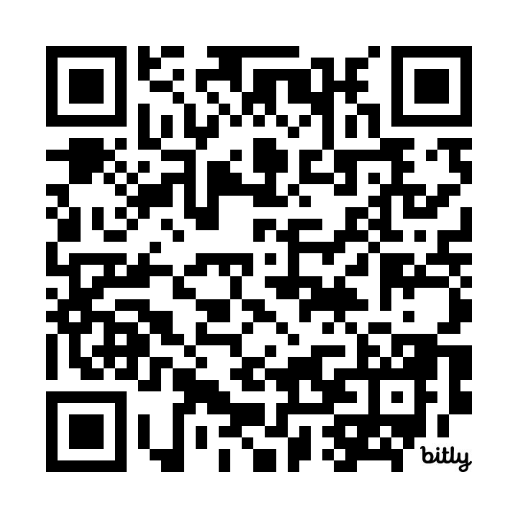
SURVEY "Web Archival Literacy"
https://bit.ly/dhbeneluxsurvey
Notes:
Let’s do the introduction first

Slide 59
Thank you!
PS: Don't forget to fill out the paper questionnaire!
Notes:
Let’s do the introduction first

Slide 60
Relevant information
BELGICAWEB project: https://www.kbr.be/en/projects/belgicaweb/
BESOCIAL project: https://www.kbr.be/en/projects/besocial/
PROMISE project: https://www.kbr.be/en/projects/promise-project/
Contact details:
Friedel Geeraert (Friedel.Geeraert@kbr.be)
Christina Vandendyck (Christina.vandendyck@kbr.be)
Peter Mechant (Peter.Mechant@UGent.be)
Eveline Vlassenroot (Eveline.Vlassenroot@UGent.be)
Yu Tao (Yu.Tao@student.kuleuven.be)

